Slide 1


Presenta

Slide 2
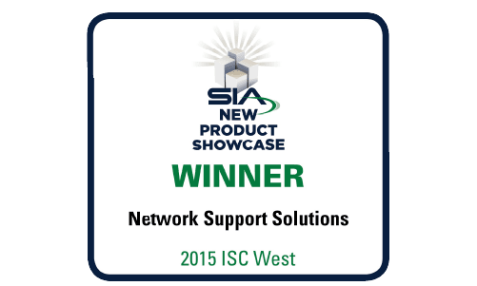
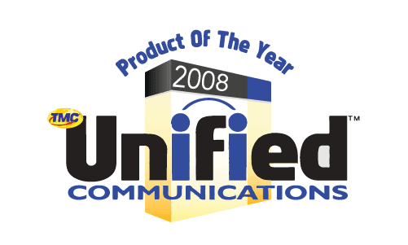



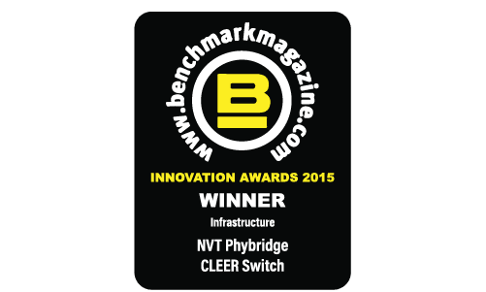
Innovazione PLURIPREMIATA!

Slide 3
Una FORMULA SICURA per il FUTURO del TUO BUSINESS!
Famiglia NVT Phybridge CLEER
Sistemi di trasmissione su cavo coassiale
Fornisci DATI e PoE+ su cavi coassiali con una portata fino a 1.830 m
Sfrutta qualsiasi infrastruttura di rete nuova o esistente
Supporta dispositivi IP e IoT fino a 18 volte più lontano
Modernizza senza rischi, interruzioni o complessità

Slide 4
Che cos’è Ethernet su COASSIALE?
Ethernet over Coax (EoC) si riferisce a un insieme di tecnologie che supportano la trasmissione di dati Ethernet su cavo coassiale.
La tecnologia Ethernet Over Coax (EoC) esiste da molti anni. Alla fine del 2014, NVT Phybridge ha introdotto lo switch gestito CLEER24; uno switch Ethernet over Coax a 24 porte che ha risolto diversi problemi con la tecnologia Ethernet Over Coax (EoC) esistente. Oggi, la famiglia di switch ed extender NVT Phybridge Ethernet Over Coax (EoC) fornisce velocità Ethernet elevate e PoE ad alta potenza al mercato Ethernet Over Coax (EoC).
Lo switch Ethernet Over Coax (EoC) gestito da NVT Phybridge CLEER24 fornisce Ethernet e PoE+ su cavo coassiale con una portata fino a 6.000 piedi (1.830 m), ovvero 18 volte più lontano degli switch PoE standard. Lo switch CLEER24 supporta anche latenza ultra bassa e larghezza di banda full duplex.

Slide 5





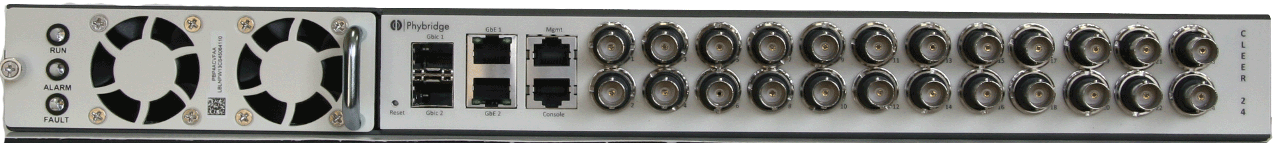
Il vecchio analogico oggi, il nuovo IP di domani
Analog
Monitor
TLC analogica
Coassiale esistente
DVR
Analog
TLC analogica
Ethernet & PoE+
100mbs with
609m Reach
(Power over Long Reach Ethernet)
PoE
PoE
Data
100 Mbit
Data
100 Mbit
IP Service
Monitor
NVT 24 Port CLEER Switch
PoE
PoE
Coassiale esistente
Data
100 Mbit
Data
100 Mbit
NVR
IP Camera
1
2
Connettere i cavi coassiali all’NVT
3
EC-Link connesso al coassiale e alla TLC IP
Connettere NVT all’NVR
Notes:
The typical Analog Camera deployment would have a DVR connected to the analog camera via coax cable with many endpoints going way beyond the 300ft reach of traditional data switches.
With CLEER, the migration to IP is simple.
Step one: Racking and stacking the CLEER switch and connecting the uplink port directly into the NVR or consolidating switch for larger deployments.
Step two: Connect the existing coax infrastructure into the downlink ports of the CLEER Switch and lastly
At the camera end connect the coax to the EC link adapter and RJ45 to the IP device.
Power up! Ethernet and PoE is being delivered to the IP end point from the CLEER switch that can be over 2,000ft away.
Deployment is complete. It is that simple. No IDF closet requirements, no disruptions, just a simple, risk free and graceful way to migrate to IP.

Slide 6
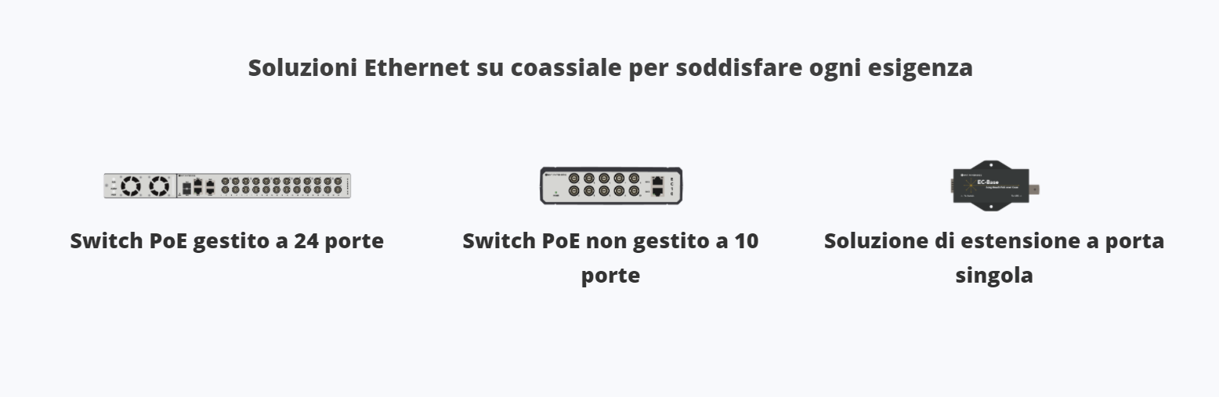
La linea CLEER

Slide 7
EC LINK Extender
Estendere Fast Ethernet & PoE su Coassiale
Coppia di due EC-Links come Extender su Coassiale
  Fino a 609m
100Mbps Delivered at Wire Speed
Connects to any always on PoE Switch
Delivers Ethernet and PoE to IEEE 802.3af or 802.3at compliant device
Locally Power the EC Link Adapter at Base or Camera Unit
48VDC Local (up to 100w)
Power Optional
IP Camera
PoE Switch
PoE
PoE
PoE
EC Link
EC Link
Data
Base
Data
Data
48VDC Local (30w)
Power Optional
Notes:
The EC link adapter can also be paired together as a single port solution. There is a toggle on one side of the adapter that you move over and it becomes the base unit that connects to the PoE switch.
The EC link adapter leverages the coax infrastructure and another adapter is installed at the camera end.
The PoE will come from the PoE switch or you can locally power the EClink adaper either at the base unit delivering 30 watts over the coax or at the camera end delivering over 100 watts over the RJ45 cable.

Slide 8
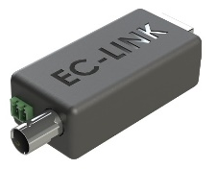

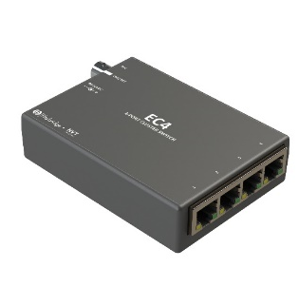
EC10 Switch - Fast Ethernet & PoE+ with over 2,000ft (609m) Reach over Coax.
PoE
PoE
100mbs Symmetrical Full Duplex PoLRE Technology with
2,000ft (609m) Reach
(Power over Long Reach Ethernet)
Data
Data
Monitor
Existing Coax Infrastructure
1 to 1
EC10 Switches
Plus 300ft
NVR
Any IEEE compliant device.
Fast Ethernet and PoE
48VDC Local Power Optional up to 100w
Reach & Power Chart
 | 300ft (92m) | 600ft (183m) | 900ft (275m) | 1,300ft (396m) | 1,700ft (518m) | 2,000ft (609m)
RG6 18AWG | 30 watts | 28 | 26 | 23 | 20 | 17
RG59 20AWG | 30 watts | 27 | 25 | 22 | 17
EC 4
CAT5 Cable
1 to 4
Notes:
This is a diagram of an EC10 deployment.
At the IP end point device you have the EC Link that is one to one or the EC4 which is one in and four Ethernet ports out for multiple IP end point deployment from one coax cable input.
In addition to the switch delivering up to 30 watts of power to the IP end point, the EC link and EC 4 can be locally powered to deliver 100 watts of power to the end points
The reach from the EClink adapter to the camera is the standard 300ft (100m) Ethernet reach limits.
The PoE available at the end point will vary depending on type of cable and distance.

Slide 9
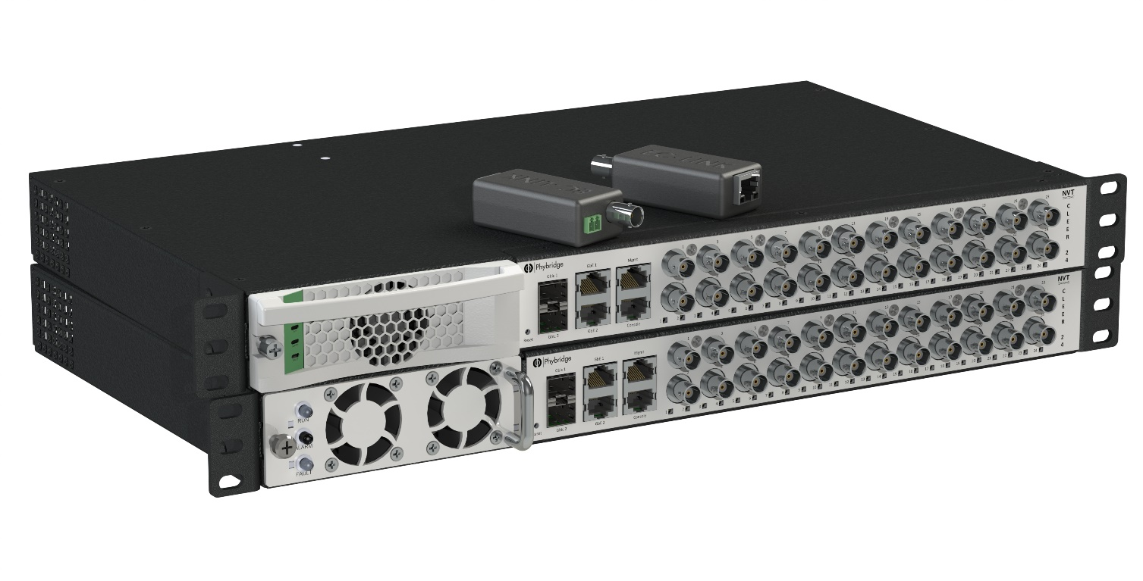
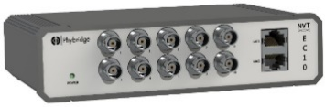
Enterprise Grade Ethernet over Coax Switch
BUILT IN NORTH AMERICA
EC Link Adapters
EC 10 - 10 Port Unmanaged Switch
24 Downlink Ports
Mgmt. & Console Ports
PowerWISE
500/1,000W power supply
Hot swappable
AC/DC Power Source
Power Sharing
Power Management
2 x 1GB Ethernet Ports
2 x 1GB Fiber Ports
Industry Leading Power
Notes:
At every end point you would have the Eclink that supports the IP end point.
The enterprise grade NVT CLEER switch has 24 downlink Ports each able to deliver 100mbs full duplex with PoE+ to an IEEE compliant device.
There is a management and console port for local access into the industry leading management GUI interface.
Two 1 GB Ethernet ports and two 1GB fiber ports for campus like deployments.
CLEER comes standard with PowerWISE technology including:
Power budget of 500w at 110v and 1000w at 220v. There is an optional 1,600 watt supply available.
Power supply is hot swappable
You can use either AC or DC power source
You can stack up to 4 switches together to create redundancy and power sharing.
And you can remotely manage the power for each port. No more truck rolls.
Now lets look at how the switch makes your IP migration quick and easy.

Slide 10
CLEER Enterprise Grade Switch Features
Feature | Benefit
100mbs per port (symmetrical, full duplex) - Wire speed | Support HD, Megapixel & Other Application
Over 2,000ft (609m) Reach on coax cable | Eliminate need for IDF closets – Point to point
500w/1,000w (or 1,600w) Hot Swappable, Power Sharing, AC/DC | Power redundancy and flexibility
2x1 GbE Copper/Fiber Uplink Ports | Increase speeds, Spanning tree for redundancy
Dedicated Management and Console Ports. | Increase security – separate network
Layer 2 Management Features: SNMP, LLDP, VLAN | No need for additional switching hardware
Remote Switch Management | Eliminate truck rolls – Immediate response
Power Control By Port: Recycle or Turn Power On or Off. | Eliminate truck rolls – remote reset
Port Locking for Higher Security | Increase security – no access to the network
Detailed Port Statistics for Easy Troubleshooting | Easy trouble shooting - Improve response times
Supports IEEE 802.3af & 802.3at compliant Devices | Create IP backbone for IP devices
An Intuitive Web GUI Simplifying Management | Easy onboarding for staff
Notes:
The CLEER switch is an Enterprise grade switch including many of the features expected from customers wanting a robust IP platform.

Slide 11
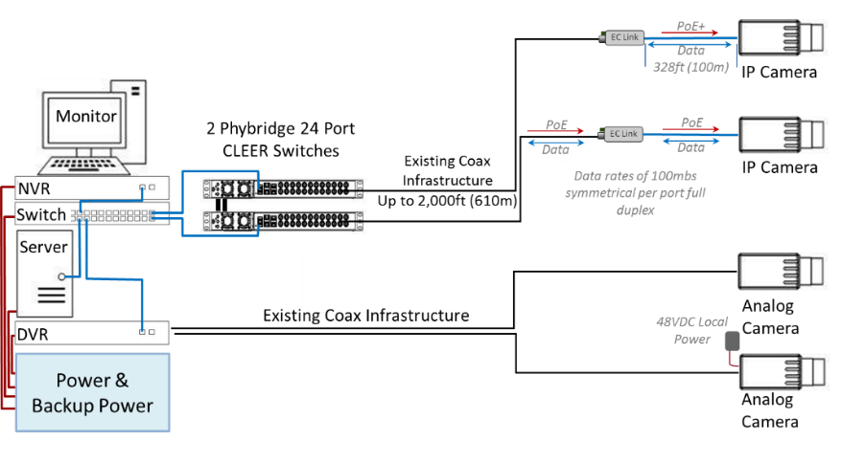
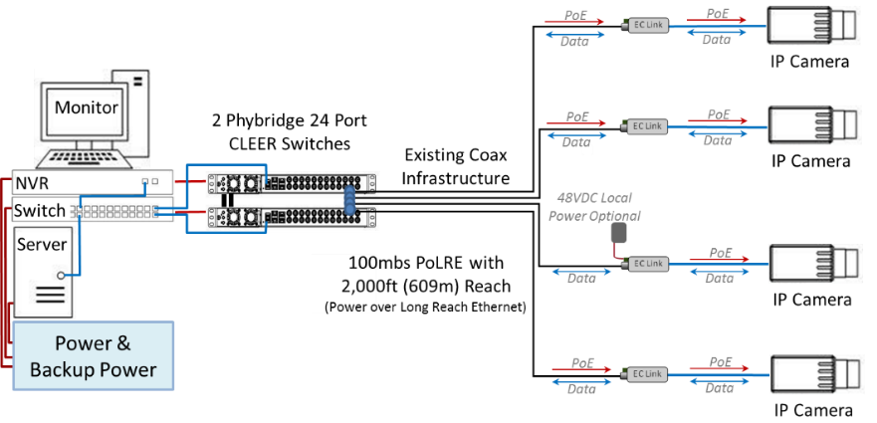
CLEER SWITCH CUSTOMER BENEFITS
Analog to IP - Quick, Easy and Lower Cost.
From Partial IP
Reduce Infrastructure Costs - Better ROI
No cabling, no IDF closet requirements; less planning costs.
Better PoE port utilization.
No Business or Network Disruption
  Leverage existing infrastructure
  Simplify network management for IP video.
Eliminate Risk
  Easy real-world proof of concept.
  No pricing risk by leveraging existing asset.
  End-to-end control. No dependencies.
Robust - Installation & Management Made Simple
  Robust separate LAN in line with industry best practice.
  Easy to configure, plan and install
  Easy to troubleshoot and manage.
Industry Leading GUI interface.
To All IP Made Simple
Notes:
Let’s look at some of the key customer benefits:
First of all you are in control of your IP camera migration. You can move from partially deployed with high value cameras being migrated to full IP on your terms.
To full migration as the budget becomes available.
Customers are realizing over 70% in infrastructure savings.
The larger the deployment the greater the savings given LAN complexities. You will also have better PoE port utilization given all the switches are in one location vs distributed throughout the building.
More savings means you can allocate more of your budget to applications and better cameras that will drive a better return on investment.
No business or network disruption by leveraging the existing proven coax infrastructure to create a separate network for your IP cameras.
Eliminate Risk by completing an easy real-world proof of concept and given you are leveraging an existing infrastructure you can avoid many of the unknowns associated with a rip and replace LAN installation.
Create a separate robust LAN in-line with industry best practice that is easy to configure, install, troubleshoot and manage.
Also the CLEER switch comes standard with an easy to use intuitive WEB GUI interface. Lets take a look at the GUI capabilities.

Slide 12


Prova con mano la rivoluzine!
Chiedici il DEMO KIT

