Slide 1
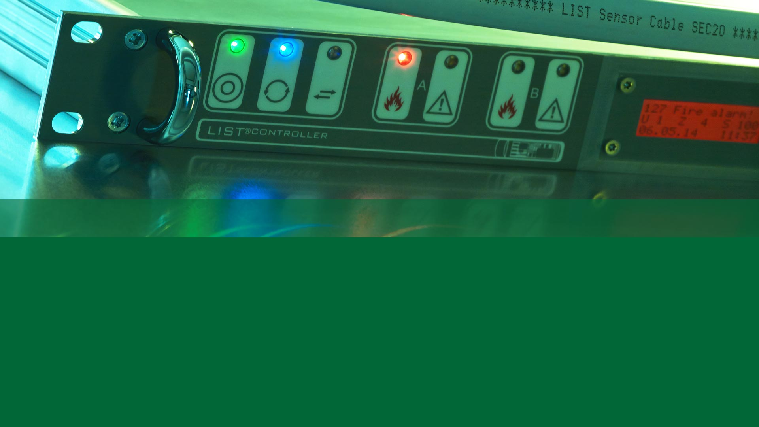
SecuriSens LIST & d-LIST
Sales Presentation
Release: (06)

Slide 2
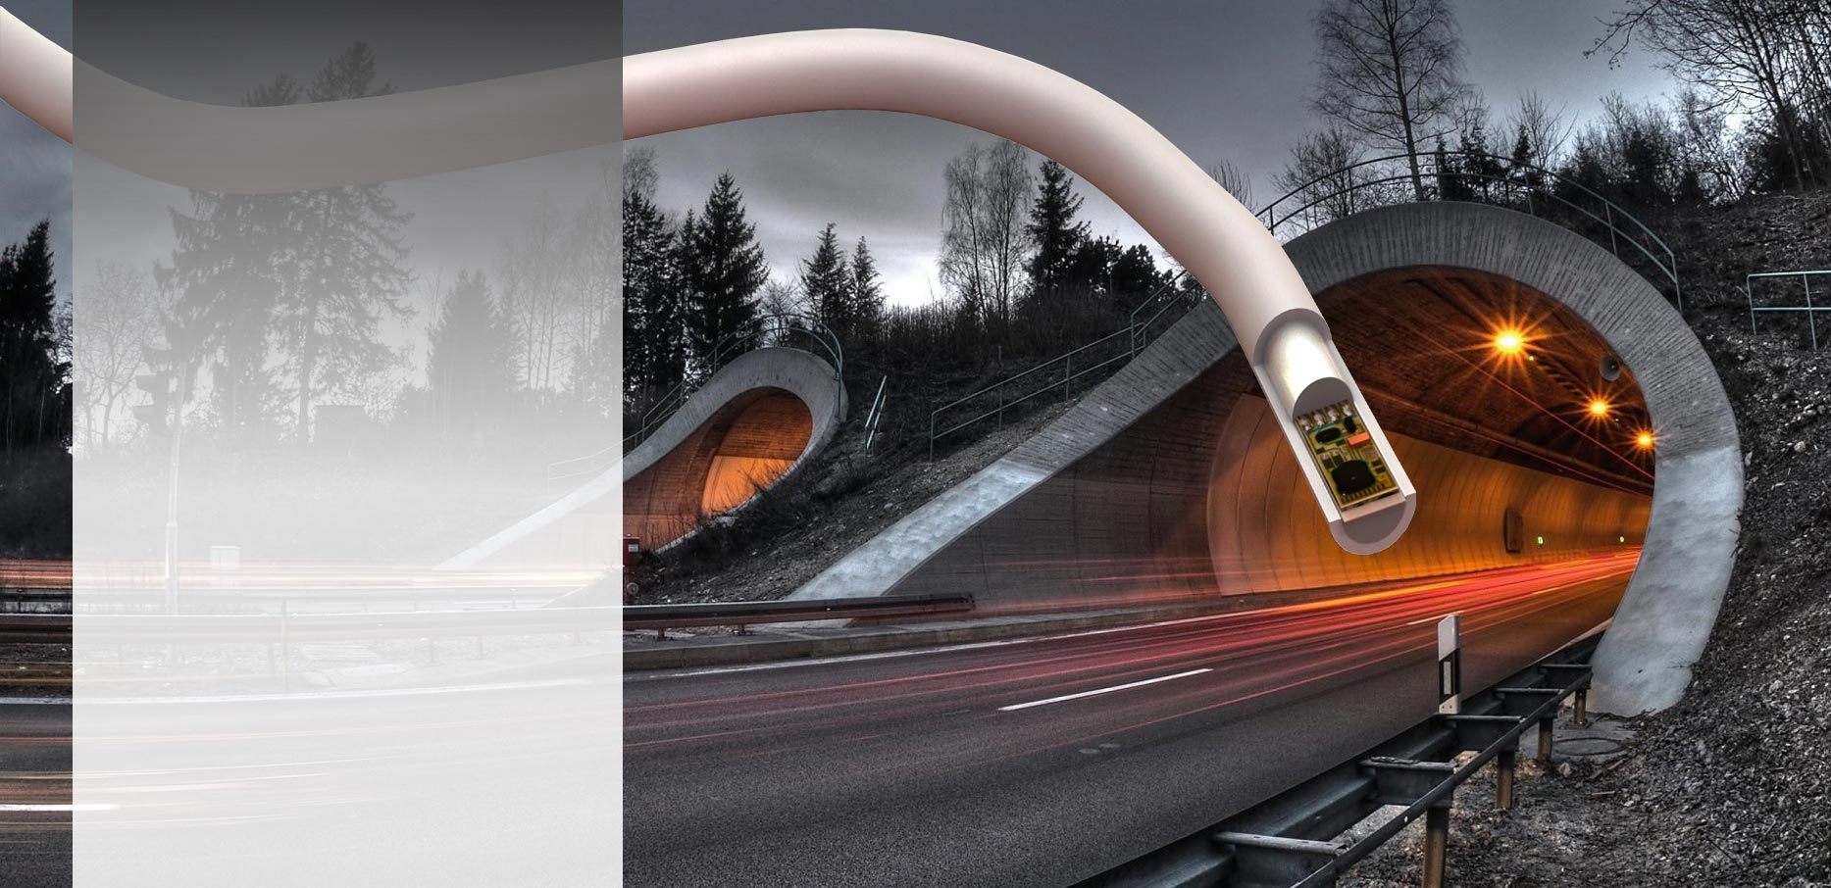
LISTEC Linear Heat Detectors Content
Principle of Operation
Application Drivers
Portfolio
Strength
Specifications
Success Stories

Slide 3
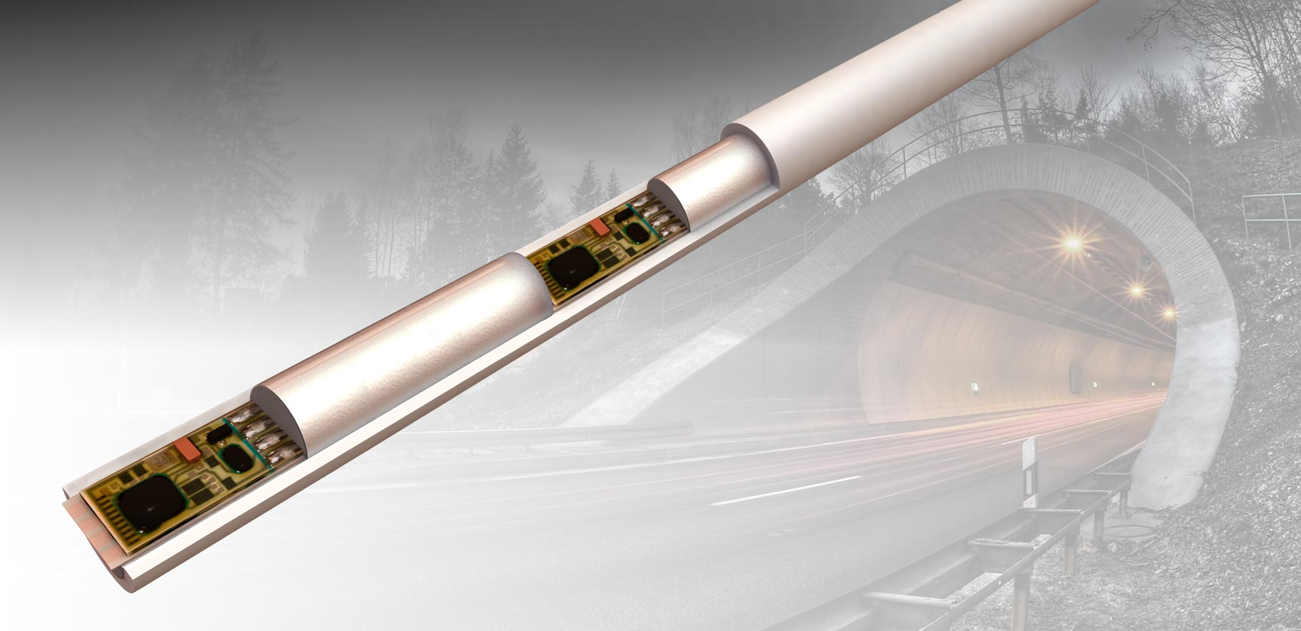
PRINCIPLE OF OPERATION Embedded Heat Sensors
  Cable Properties
  Aluminium Foil Shield
  Reinforced (strain relief)
  Installation Properties
  Radius as small as
    25cm (SEC 15)
    30cm (SEC 20)
ALUMINIUM SHIELD
  MEASUREMENT
  10s intervals
  0.1 resolution
  Repeatability ±0.1K
SPACING
SEC 15: 1, 2, 3, 4, 5 or 10 m
SEC 20: 2, 3, 4, 5, 8 or 10 m
... or to your specification

Slide 4
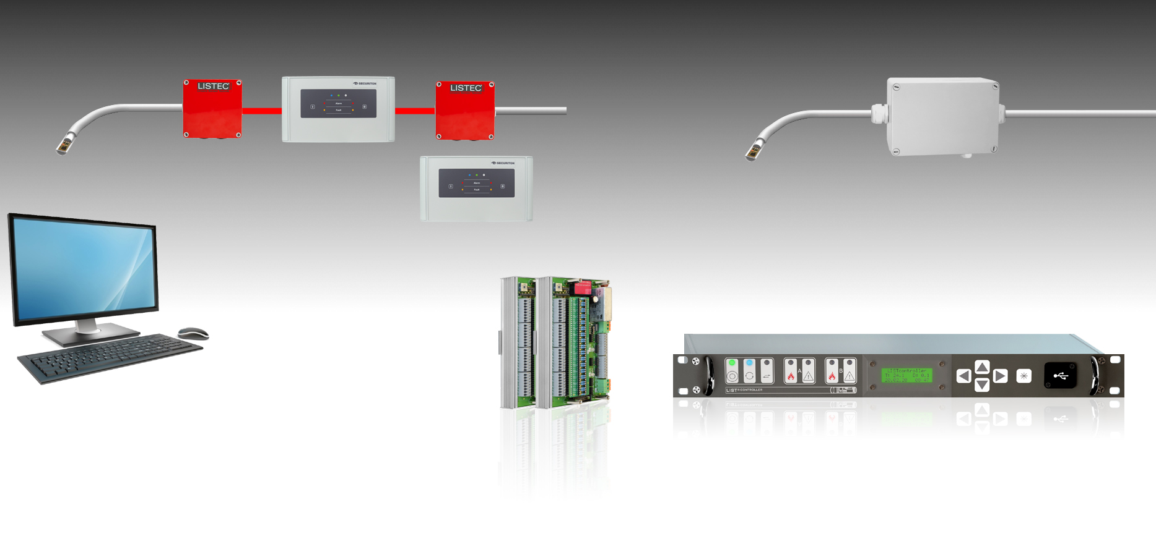
PORTFOLIO System Components
UPDATE
SEC 15 (d-LIST)
SEC 20
SCU 835
2x350 m, 2x100 Sensors
CBO 20
SEC 15
SEC 20
3.2km, 320 Sensors
CBO 15
CBO 15
CC 15
SCADA System
Building Management System
1200m
247 units
RS 485
4 (+16)
RELAYS
  LIST^{CONTROLLER}
7 (+256)
RELAYS
RS 485 (MODBUS RTU)
ETHERNET (MODBUS TCP)
RS 232 (MODBUS RTU) / ETHERNET (Modbus TCP)

Slide 5
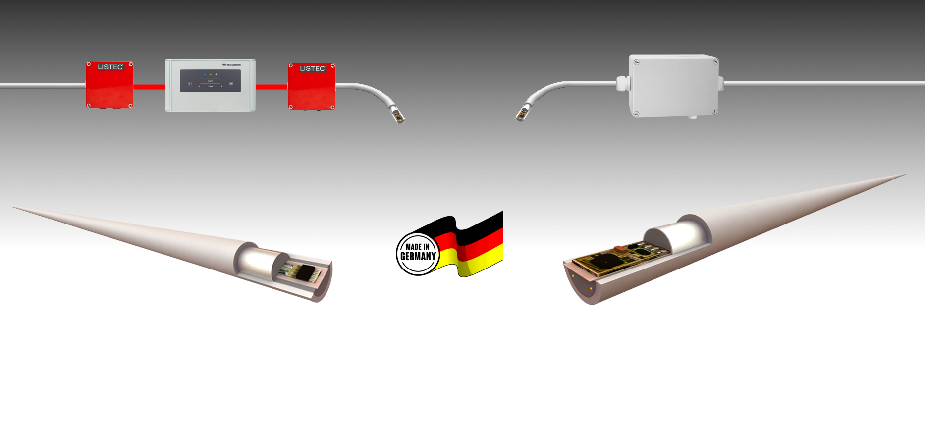
PORTFOLIO System Overview
Max. 750 m, 200 Sensors
Max. 3.2 km, 320 Sensors
CBO 15
Sensor Control Unit
SCU 835
CBO 20
  LIST^{CONTROLLER}
SEC 15 (d-LIST)
SEC 20
TEMPERATURE MONITORING
EN54-22 A1N, A2N, BN, CN, ATEX Zone 2/22
700 m (2 x 350 m)
1 / 2 / 3 / 4 / 5 / 10 m or to specification
15 mm
Typical Application
Compliance
Max. Length
Sensor Spacing
Cable Diameter
FIRE DETECTION
EN54-22 A1N, A2N, BN, ATEX Zone 2/22
3’200 m
2 / 3 / 4 / 5 / 8 / 10 m or to specification
18 mm

Slide 6
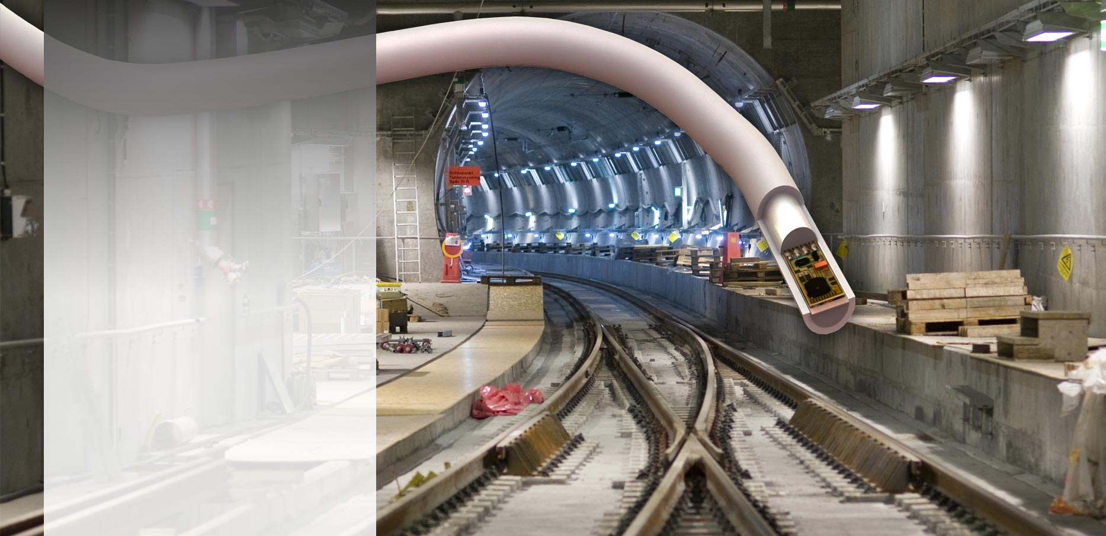
APPLICATION DRIVER Long Distances
  Long Distance Monitoring
    Road / Rail Tunnels
    Utility Tunnels
    Cable Trays
    Pipelines
    Conveyor Belts

Slide 7
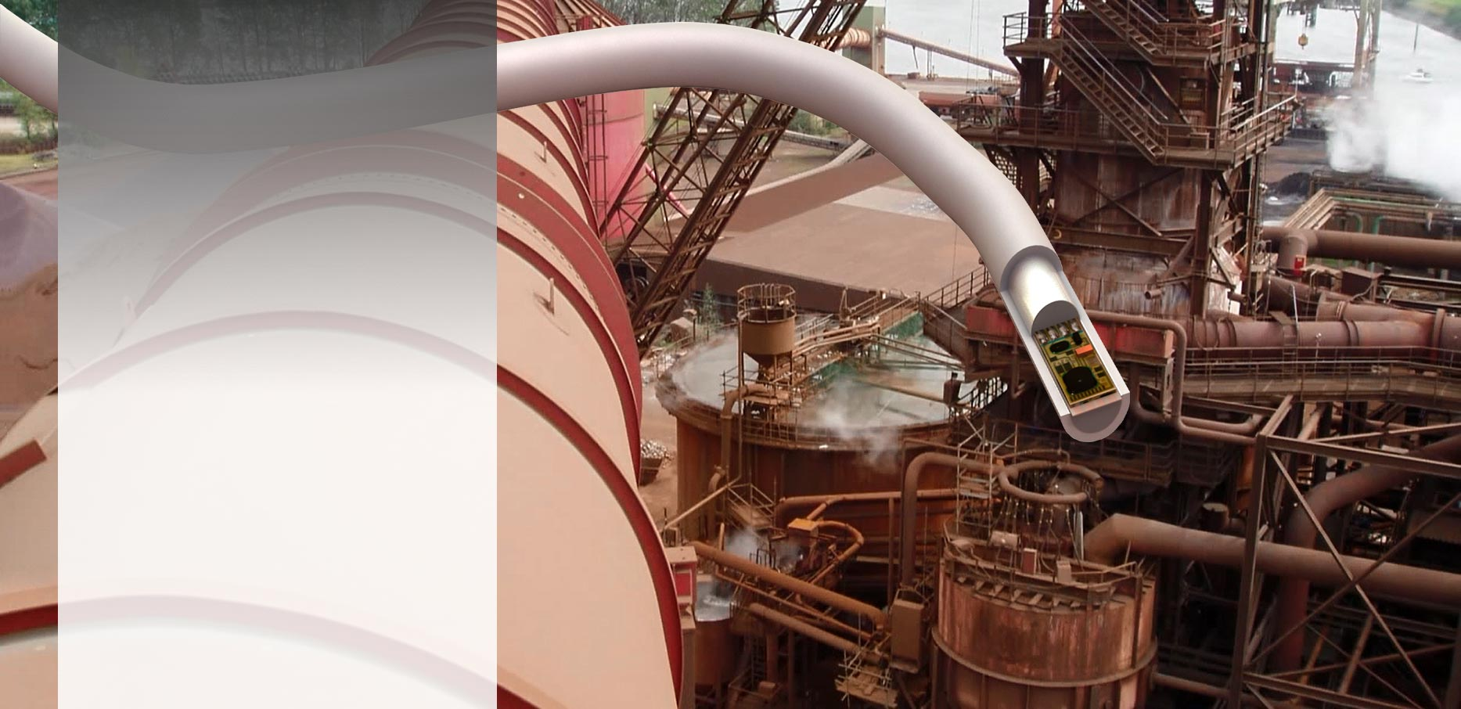
APPLICATION DRIVER Harsh Environment
  Works under extreme conditions
    Rain / Moisture
    Dirt / Dust
    Heat / Frost
    Wind
    Aggressive Gases
    EMI
    Insects

Slide 8
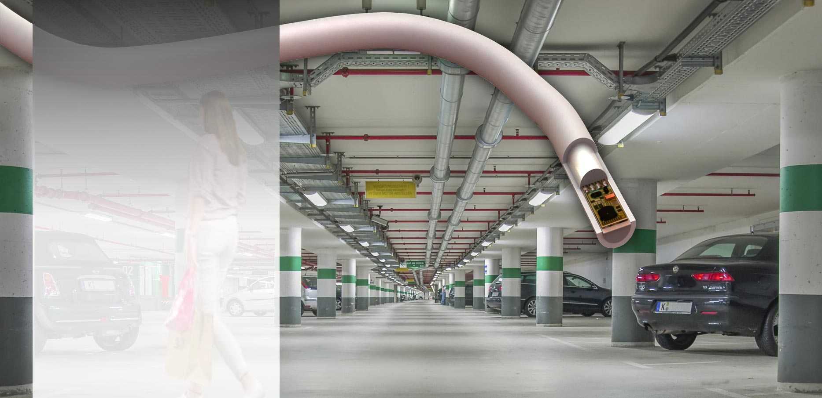
APPLICATION DRIVER Large Area
  Up to 320 parking lots per cable
    Extensive Coverage
    Pollution resistant
    Humidity resistance
    Maintenance friendly
    Zero nuisance alarms

Slide 9

STRENGTH Flame retardant
  Flame retardant and halogen free
    Hospitals
    Rail Stations
    Car Parks
    Assembly Halls
LIFE SAVING QUALITY
0
5 Min.
10 Min.
15 Min.
20 Min.
25 Min.
30 Min.

Slide 10
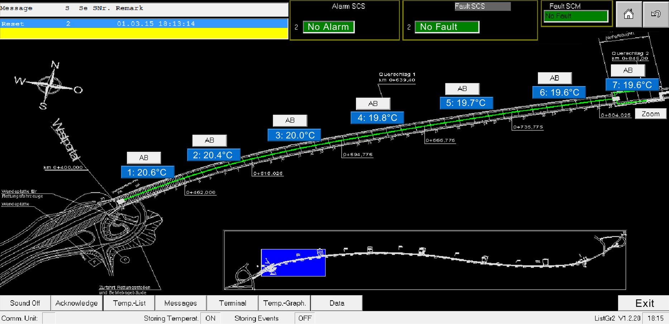
STRENGTH Monitoring

Slide 11
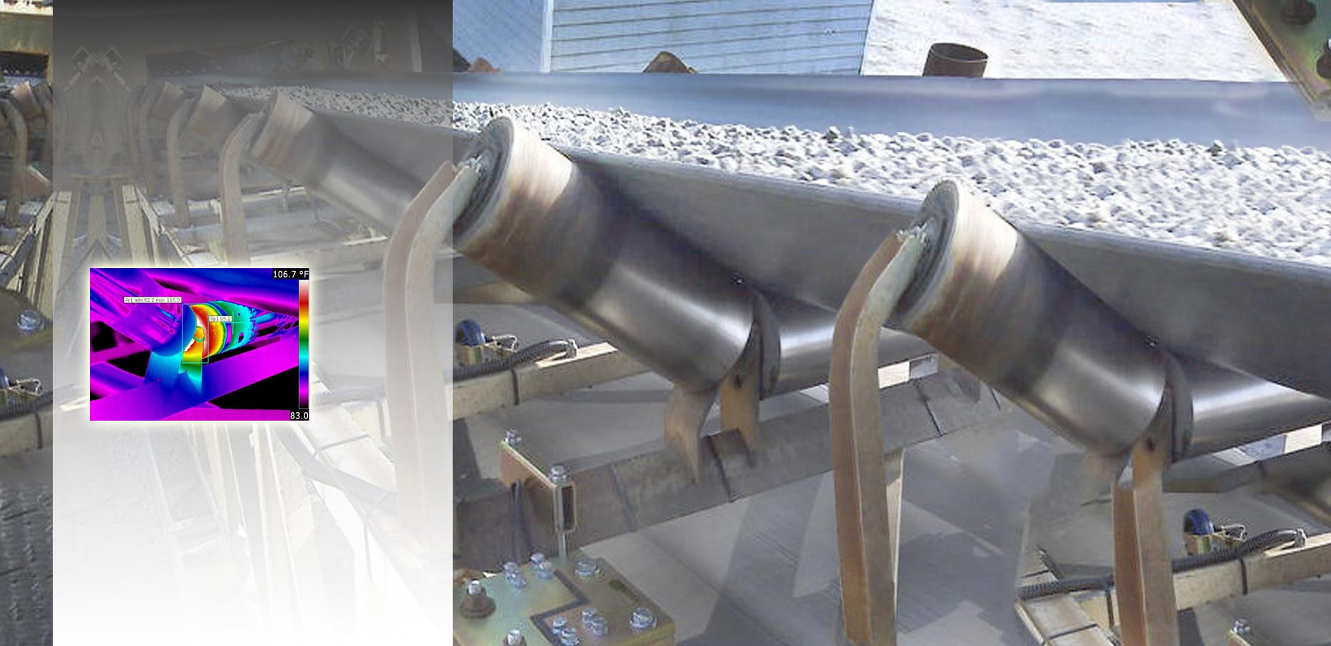
STRENGTH Point Accuracy
  Reliable, accurate and stable
    IR sensitive sensors
    Clear sensor position
    No drift no re-calibration
    Measurement Res. 0.1C
THERMOGRAPHIC IMAGE

Slide 12
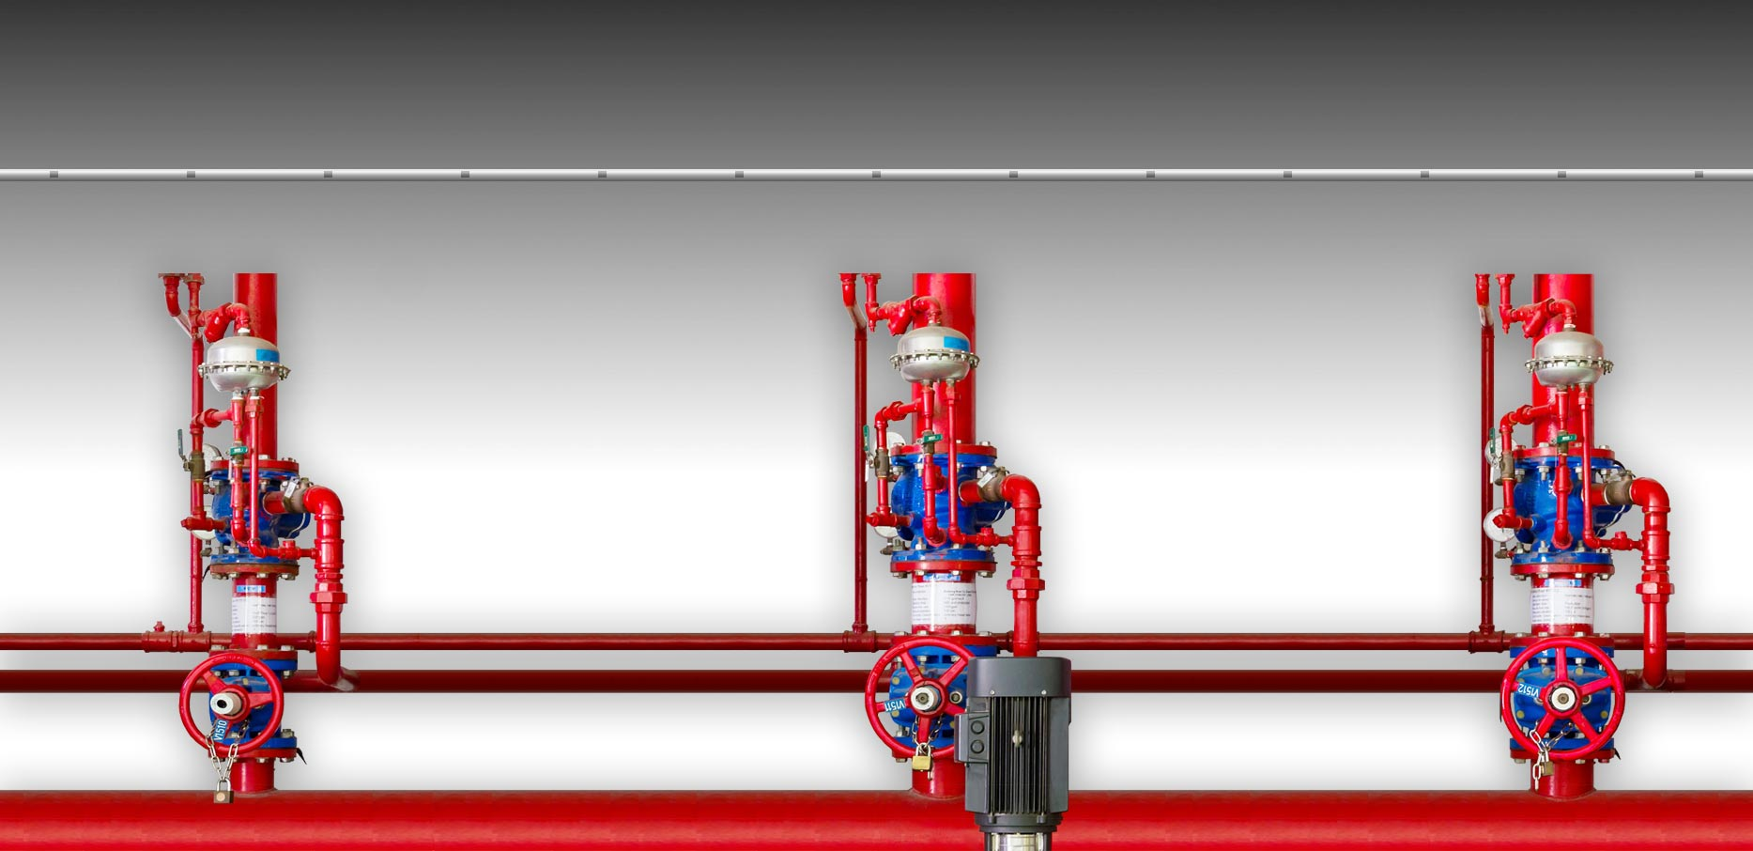
STRENGTH Accurate Zoning
Sensor 1 2 3 4 5 6 7 8 9 10 11 12 13
Zone 1
Zone 2
Zone 3
VALVE 1
VALVE 2
VALVE 3

Slide 13
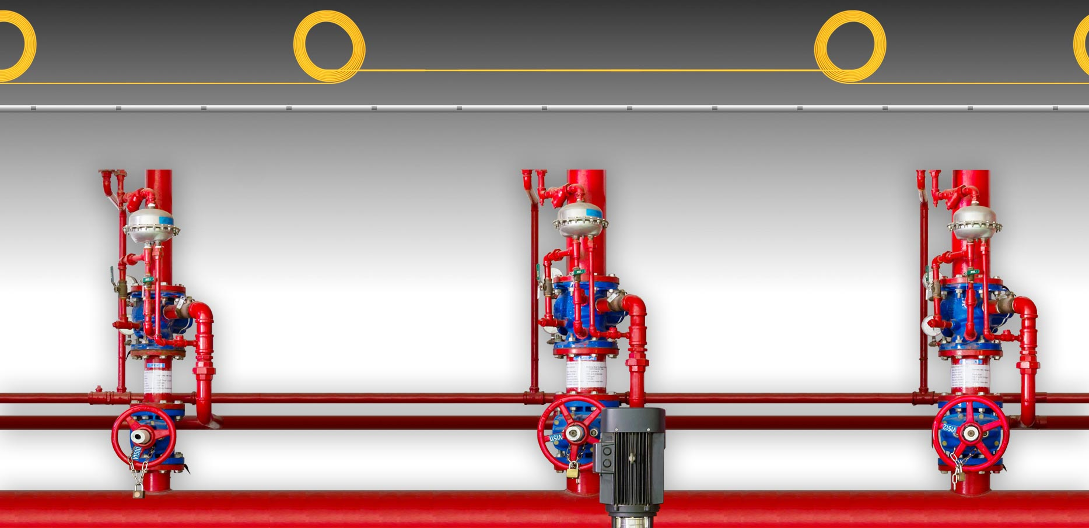
STRENGTH Zone Stability
Regular calibration needed
to maintain zone accuracy
Fiberoptic: Drift Buffer required
for reliable zoning
Min. Length of the coil:
6 x Spatial Resolution
Zone 1
Zone 2
Zone 3
VALVE 1
VALVE 2
VALVE 3
Notes:
“For an unambiguous mapping of events we recommend using an extra length of sensor cable of at least six times the spatial resolution in between the alarm zones.” (Siemens Planning Guide)

Slide 14
Question
Is the following statement true?
Absolute precise location and measurement accuracy are strengths of the LISTEC Linear Heat Detectors.

Slide 15
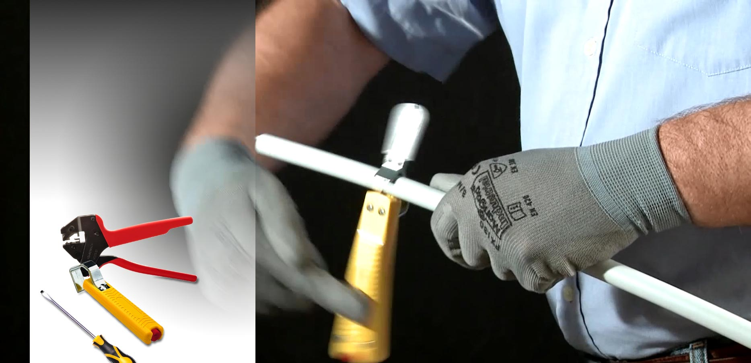
STRENGTH Installer friendly
  Normal cable properties
  → no specialists needed
  → field repairable
  → no limits to cuts & repairs
    Standard electrical tools

Slide 16
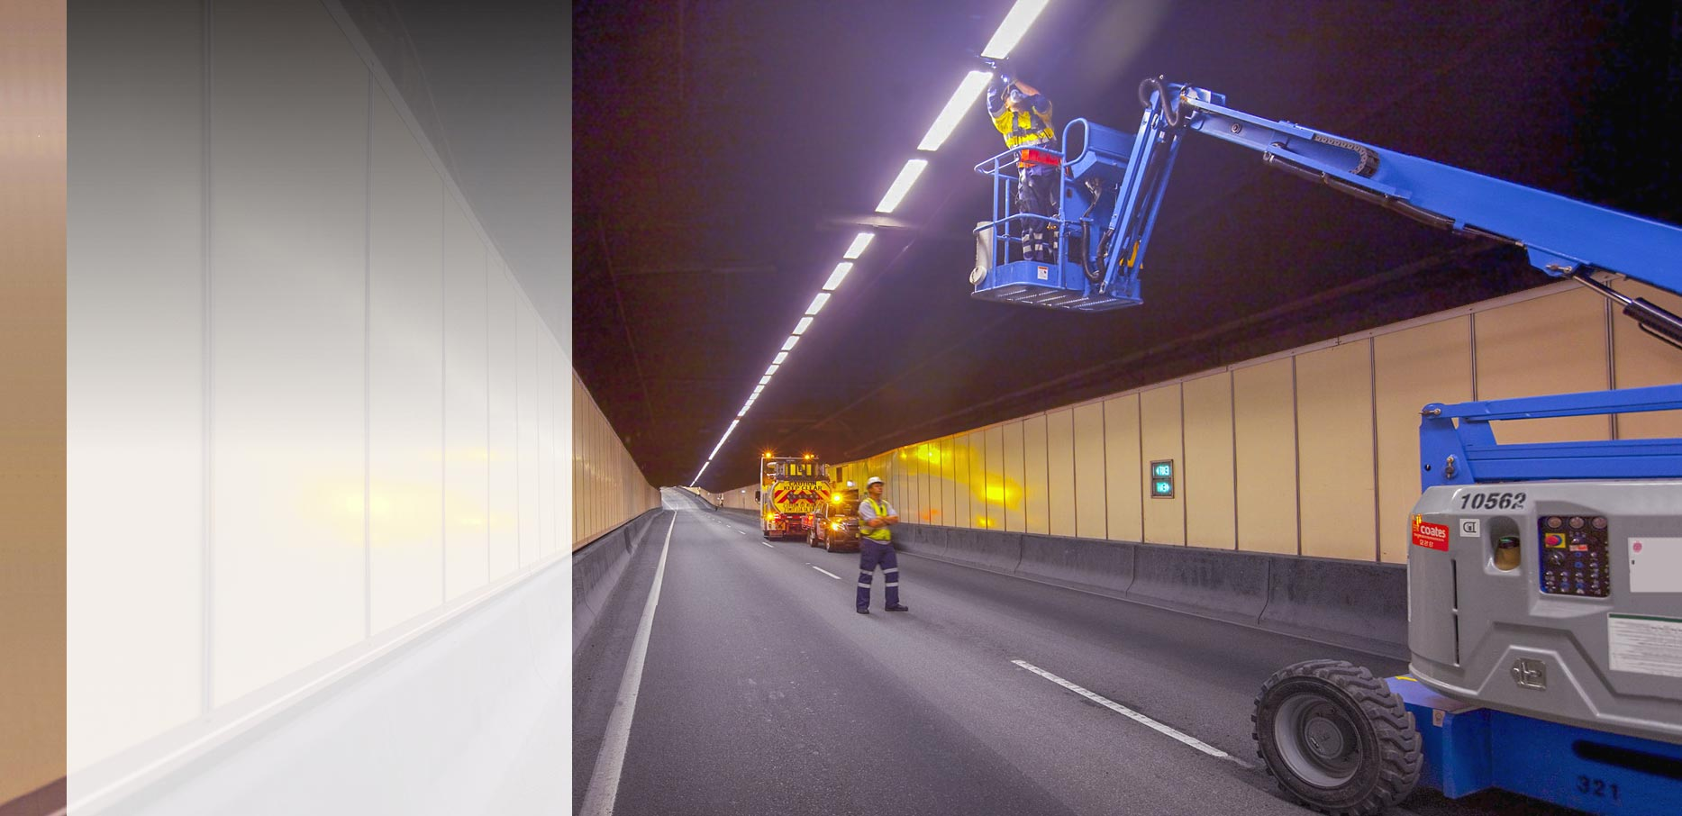
STRENGTH Maintenance free
  Less Traffic Shut Downs
  → Best Total Cost
  of Ownership
    No drift
    → no re-calibration
    Performs self-test
    → no maintenance test
    Firmware based
    → no annual fee for software licensing

Slide 17
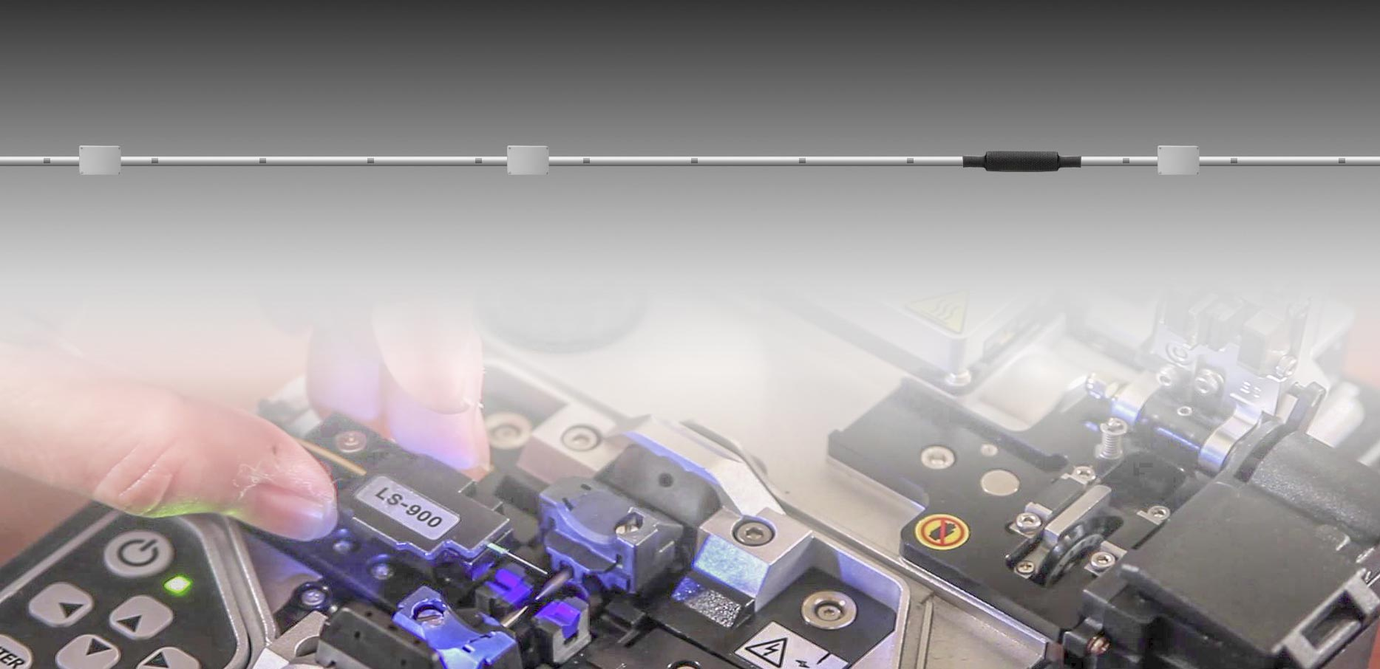
STRENGTH Nearly Unlimited Repair
  LIST Cables
    Full performance no matter how many repair patches
    Easy to repair by simple connection boxes or even cable sleeve joints
    No cable extension required for repair
  Fiber Optics
  Limited number of splices according to “Loss Budget Calculation” (next slide)
  Precise work by specialist company only
  2 Splice boxes and 2 cable coils per repair
  Subsequent re-calibration required (resolution and zoning)
  Time consuming and expensive (tunnel shut downs)
Notes:
FibroLaser Maintenance & Repair Manual:
“Cut out the damaged sensor cable section and replace it with a new cable. Use two splice boxes for this.
“The slice work may only be performed by a qualified specialist company.”
“Following the repair, the zones must be checked and must be adjusted.”

Slide 18
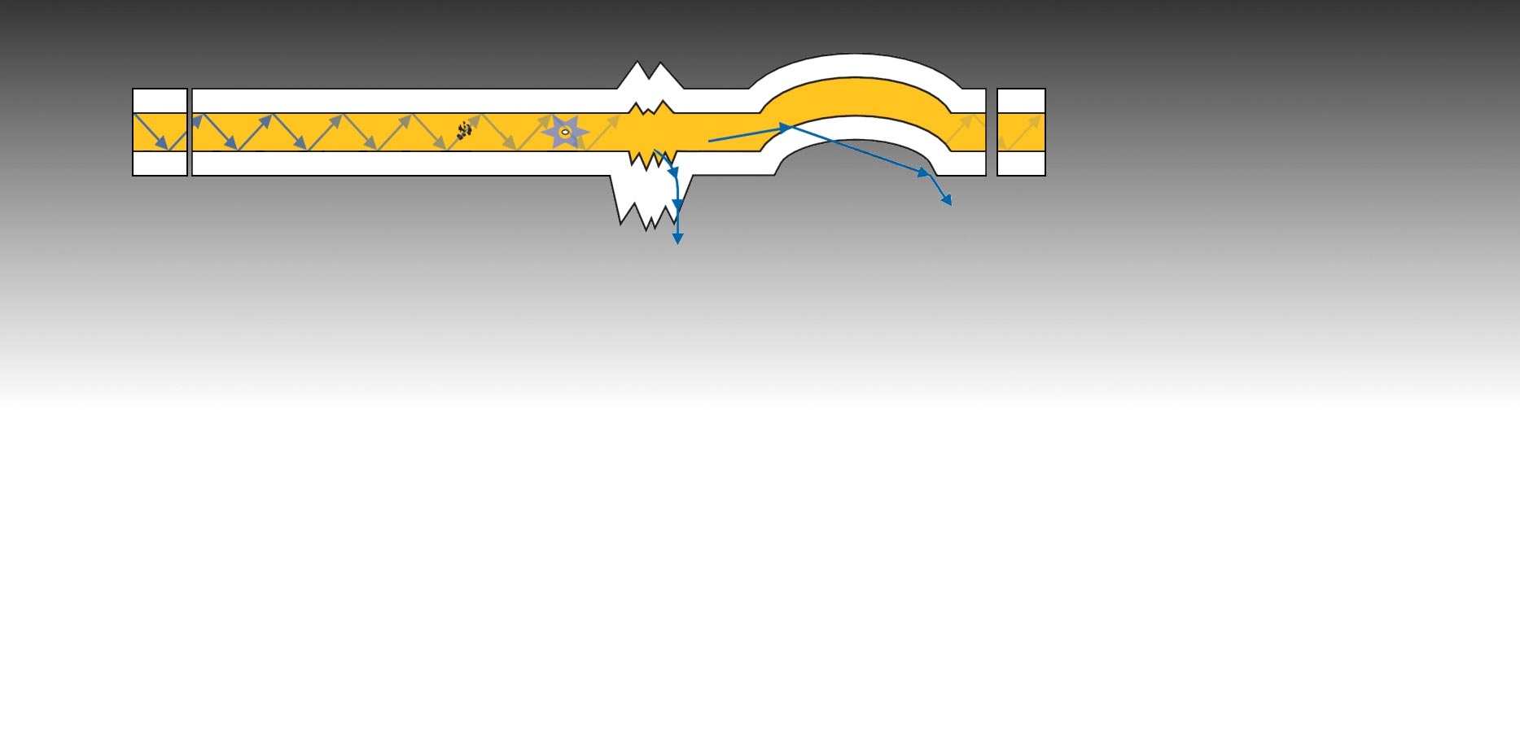
STRENGTH No “Loss Budget”
  Fiber Cable’s Loss Budget
FIBER CORE
CLADDING
(reflector)
Normal Cable Loss
Heterogeneous
Structures Loss
typically 0.3dB
typically 0.4dB/km
Connector Loss
Absorption Loss
Scattering Loss
Bending Loss
Splicing Loss
typically 0.3dB
Low
Splicing has a huge impact on cable length
Sensitivity
of the receiver
Signal Level
1 Repair = 2 splices = 300m loss
(reduced total length of cable)
High
1km
2km
3km
4km
5km
6km
7km
8km
9km
Notes:
FibroLaser Maintenance & Repair Manual:
“Cut out the damaged sensor cable section and replace it with a new cable. Use two splice boxes for this.
“The slice work may only be performed by a qualified specialist company.”
“Following the repair, the zones must be checked and must be adjusted.”

Slide 19
Question
Which of the following answers is true?
The Loss Budget of LISTEC Linear Heat Detectors is
- zero
- infinite
- irrelevant

Slide 20
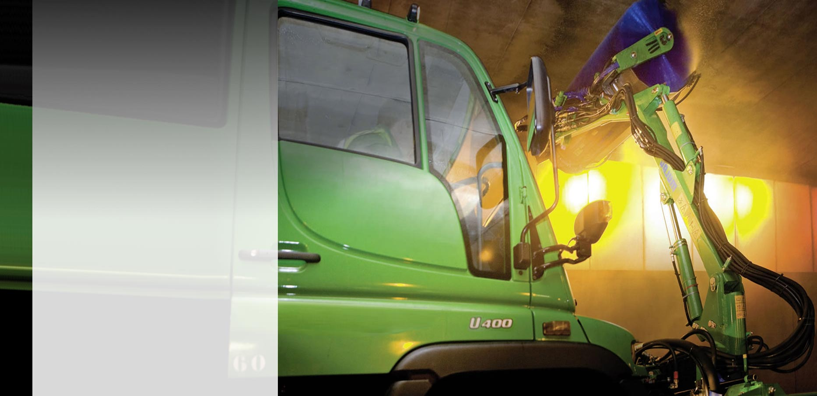
STRENGTH Water resistant
  Easy to clean
  → Mechanically and
  chemically resistant
    Water / Moisture
    Gases / Pollution
    Tensions / Shocks

Slide 21
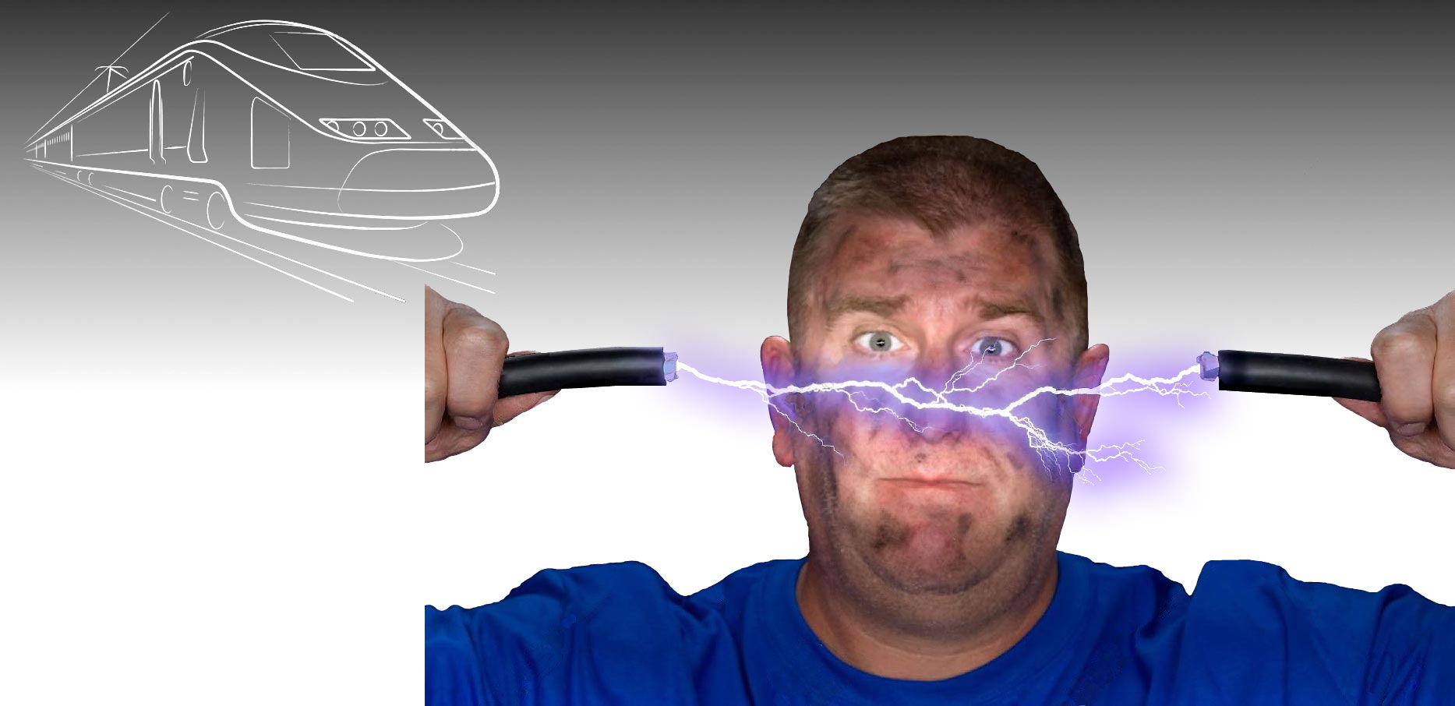
STRENGTH High EMI Immunity
0.5m
  Heavy Duty
    Tested and approved for heavy duty applications
    (railway or power transmission)

Slide 22
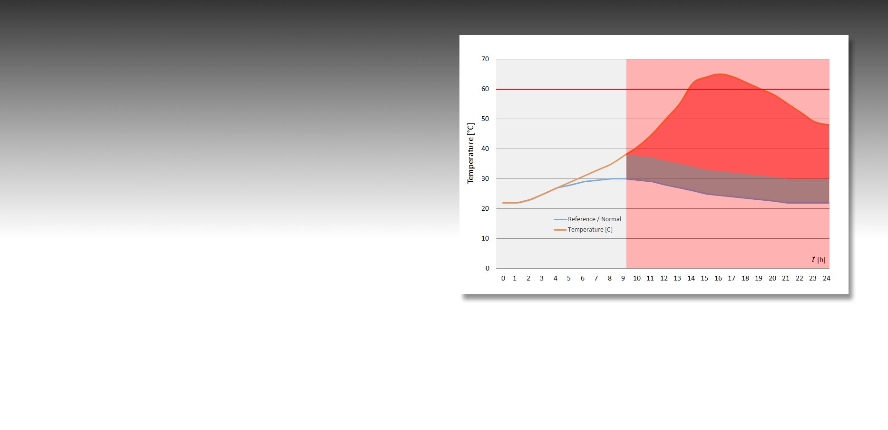
STRENGTH Max. & Diff. Alarms
  Pre-Alarms for Early Warning
24h Temperature Profile
  Max. Alarm
  Difference to 0°C
  Max. Pre-Signal
  in % of the Threshold-Alarm
  Difference Alarm
  Difference to Normal
  Difference Pre-Signal
  in % of the Diff-Alarm
Max. Alarm
Diff. Alarm
  Settings are per Zone
  Addressable

Slide 23
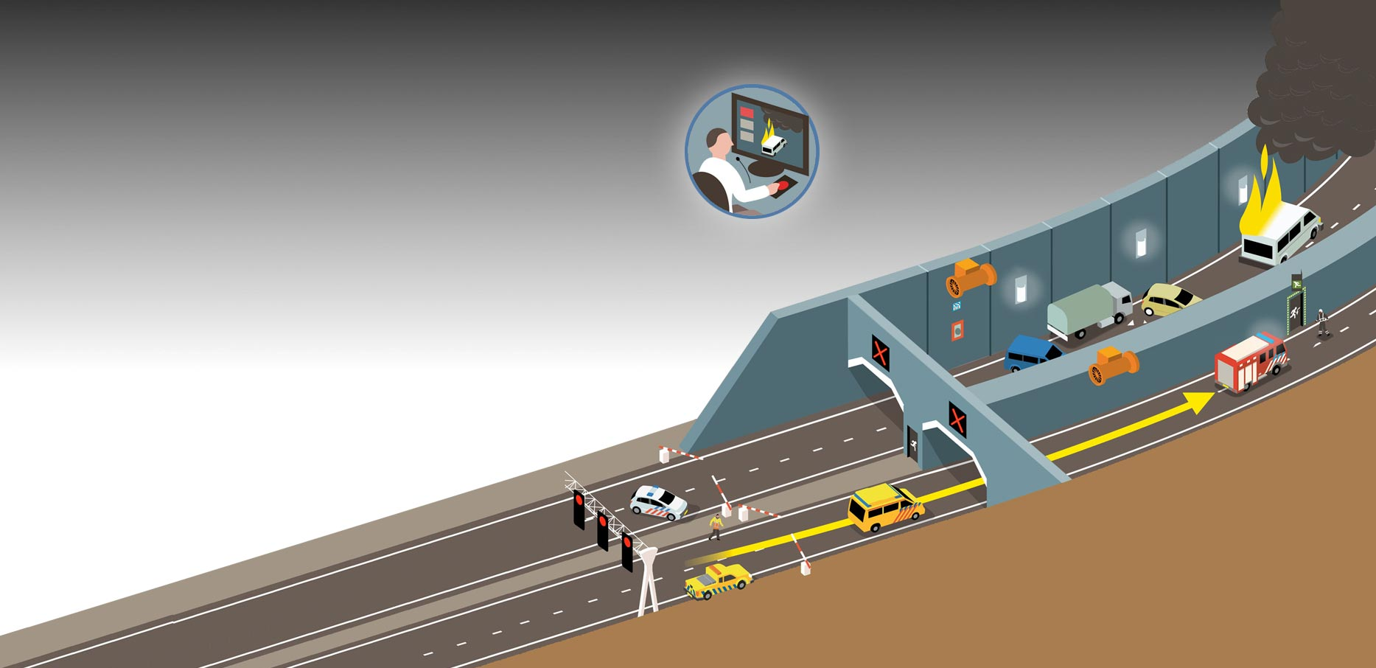
STRENGTH Multiple Alarms
  Progressive Response
Stop the trafic
Evacuate the site
Initiate fire alarm
2
Alarm
(Diff. or Threshold)
Verify the alert
Locate the cause
Call Emergency Team
1
Difference
Pre-Signal

Slide 24
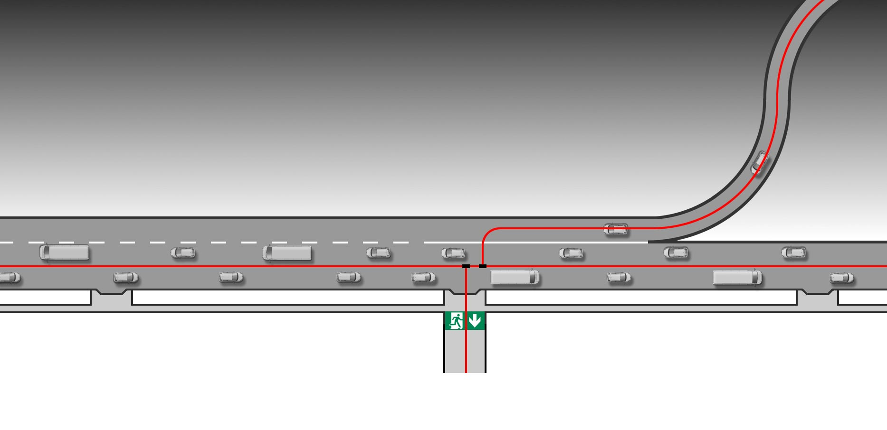
STRENGTH Branching
  Total Flexibility
  To place branches
  To add branches later on

Slide 25
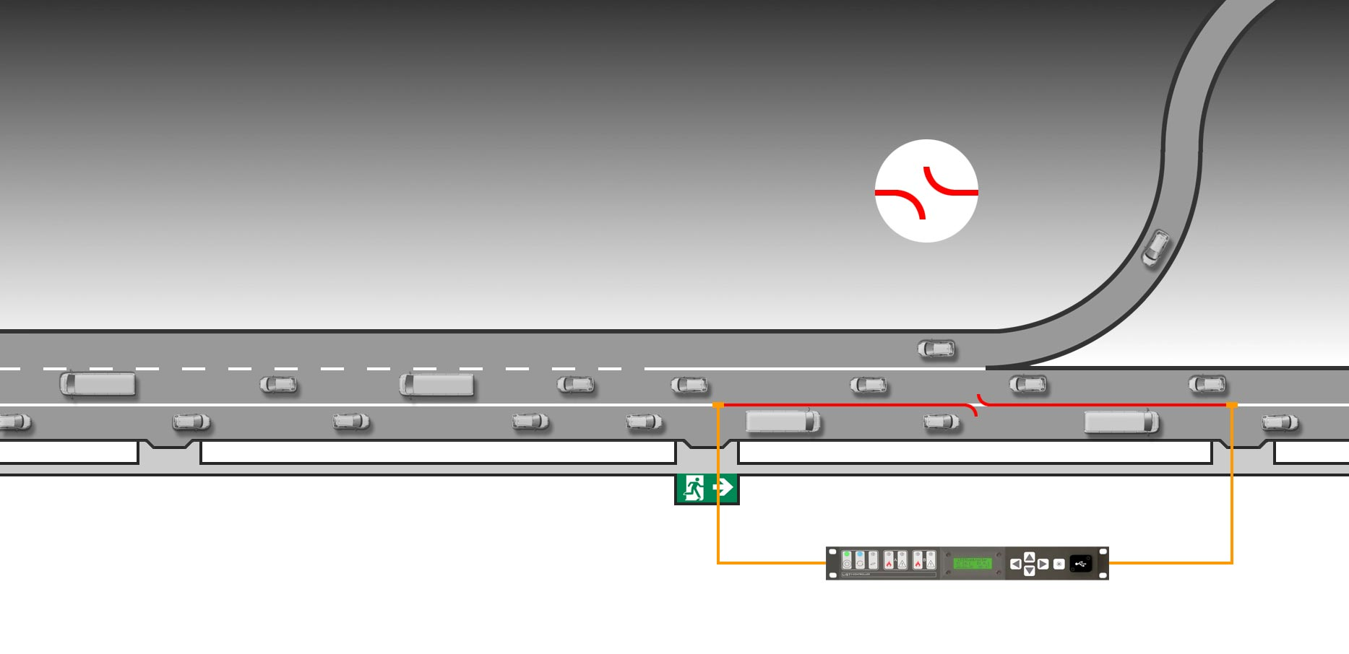
STRENGTH Failsafe
  Loop Topology:
  Detector addressing from both sides
  Full detection capability even in case of a cable cut
One cut – zero impact

Slide 26
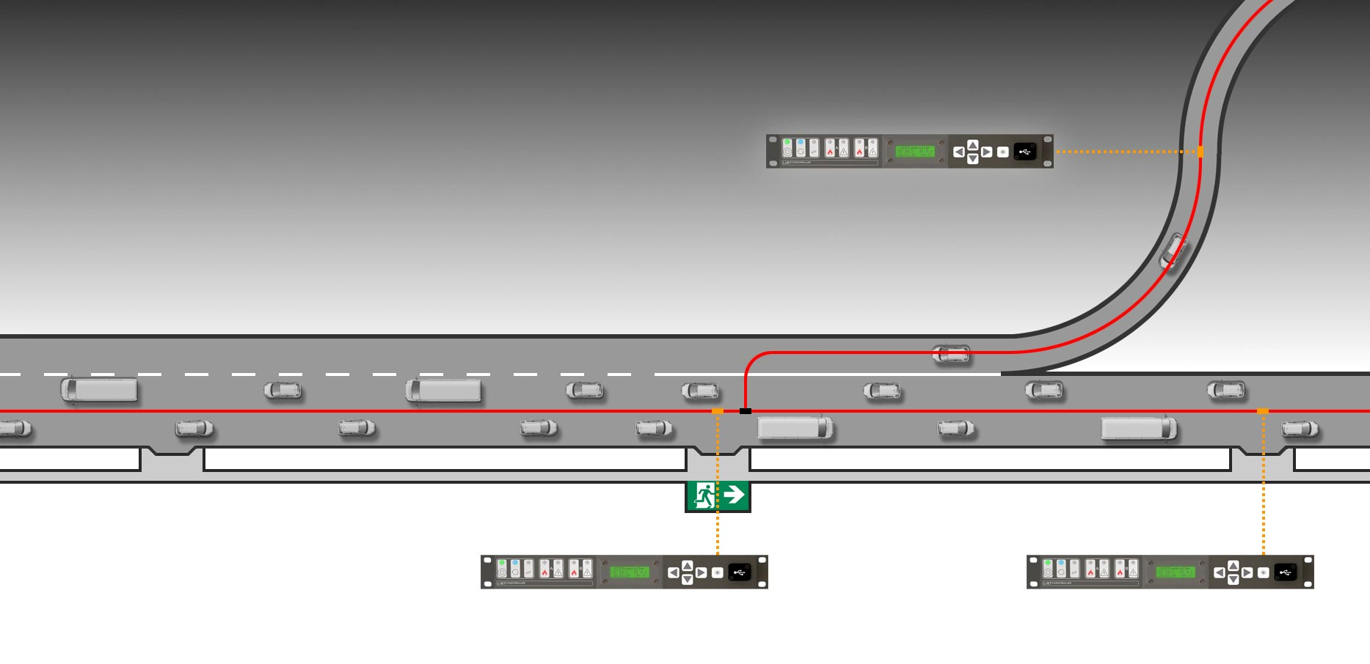
STRENGTH Controller Position
  Total Flexibility
  to connect the controller

Slide 27
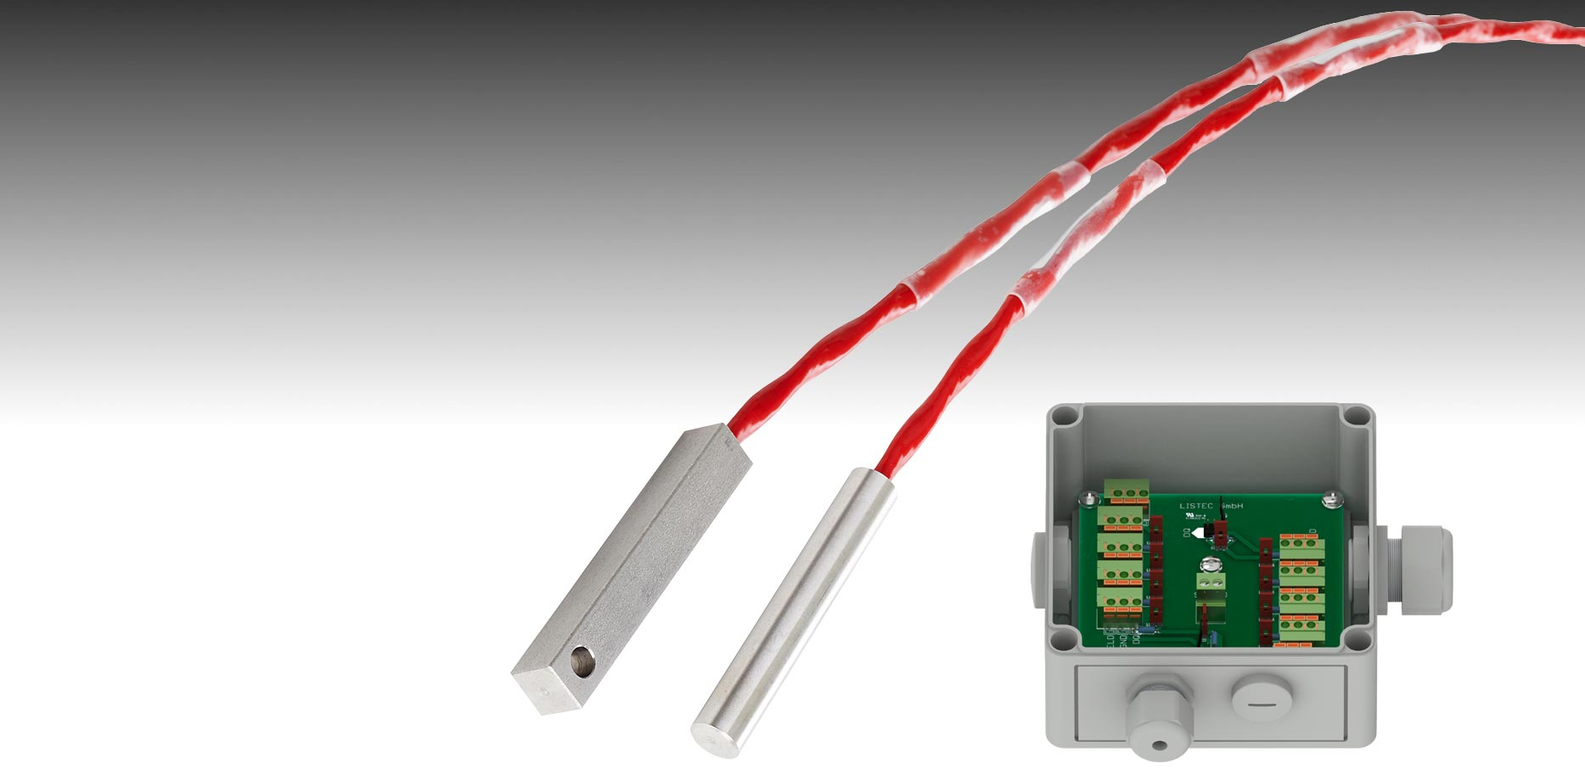
STRENGTH [SEC 15] Single Sensors
  Equipment Monitoring
  Engines
  Heating units
  Ovens
  Cooling devices
  Environment Monitoring
  Open air
  Loading docks
  Semi-covered facilities
  (Car Parks, Storage)
  In-duct Monitoring
  Ventilation systems
  Air handling units

Slide 28
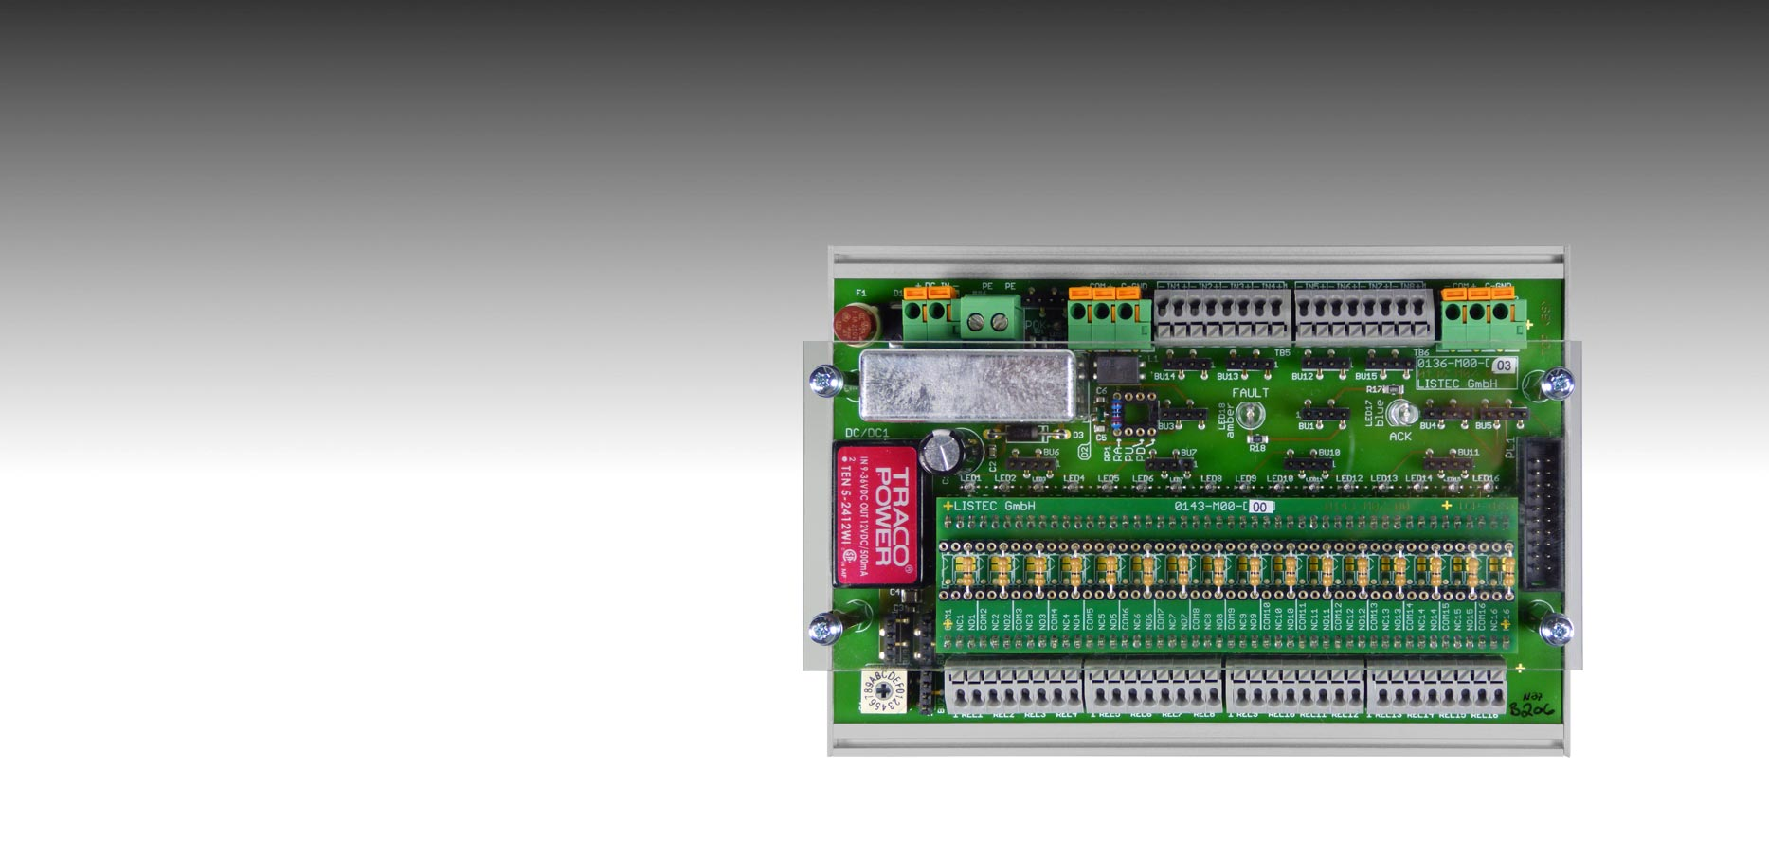
STRENGTH [SEC 20] Status Monitoring
  8 Inputs
  Opto-coupler isolated
  5 … 28VDC
  Application Examples
  Read Door Contacts
  Read Smoke Switches
  Read 3rd Party Alarm Outputs
  Check Valve Position
8 Inputs

Slide 29
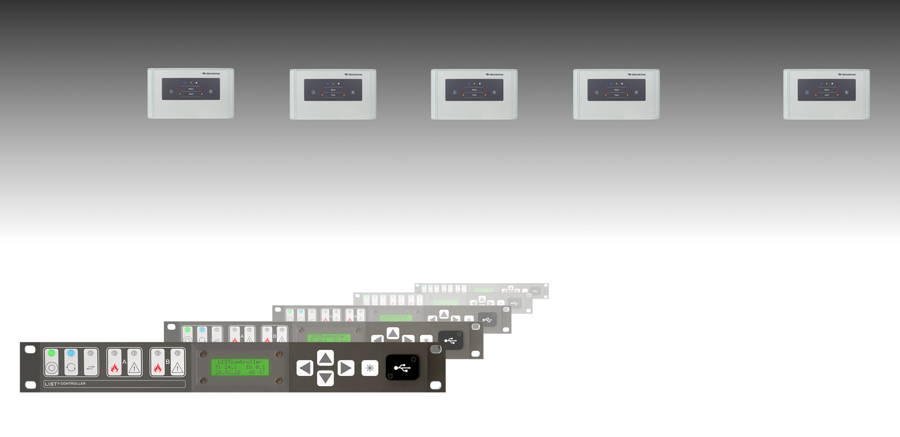
STRENGTH Networking
  SCU 835
  RS485 / Modbus RTU / 247 Participants
  Management System / Visualization
  RS485 (Modbus RTU)
  LIST^{CONTROLLER}
  32 Participants
  Ethernet (Modbus TCP)
  RS232 (Modbus RTU)

Slide 30
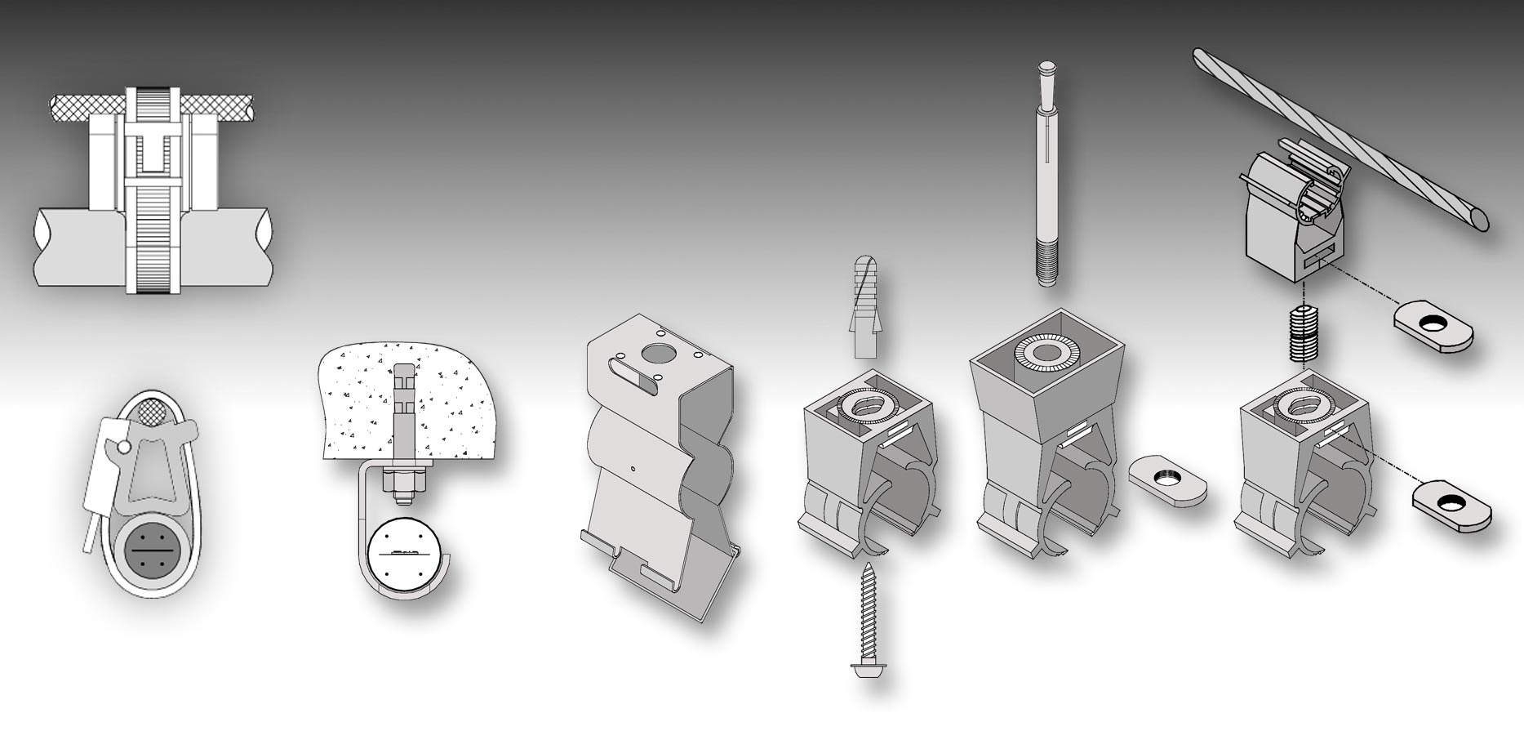
ACCESSORIES Cable Fixings

Slide 31
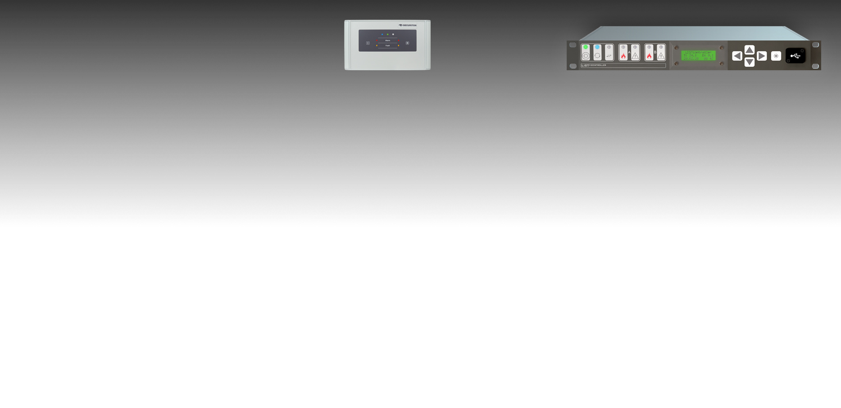
SPECIFICATIONS Control Units
Criteria | SCU 835 | LIST^{CONTROLLER}
Sensors per unit | 200 (2x100) | 350 (320 with VdS)
Sensor ID (physical address) | 1 – 65’536 | 1 - 999
Zones per system (logical assignment) | 1 - 64 | 1 - 254
Redundancy / Loop | no | yes / yes
Relays (monitored 48VDC/250mA) | 4 (+16) | 7 (+256)
Measurement Temp. Range | -40°C to +120°C | -40°C to +200°C
Operating Temp. Range | -25°c to +70°C | -25°C to +70°C
Protection Class | IP 65 | IP 54
Power Requirements | 10.5 … 30 VDC / 5.5 W | 9.5 … 36 VDC / 5 W
Networking (LISTnet, up to nn units) | RS485 or Ethernet, up 247 units | RS485 or Ethernet, up to 32 units
Management System I/F | RS232 / RS485 / Ethernet | RS232 / Ethernet
Programming & Data Communication | RS232 / RS485 / Ethernet / USB | RS232 / Ethernet / USB
Data Logging Port | RS232 / RS 485 / Ethernet | RS232 / Ethernet
Max. Number of Events in Memory | 1000 | 450
Approvals | VdS | VdS, ATEX

Slide 32
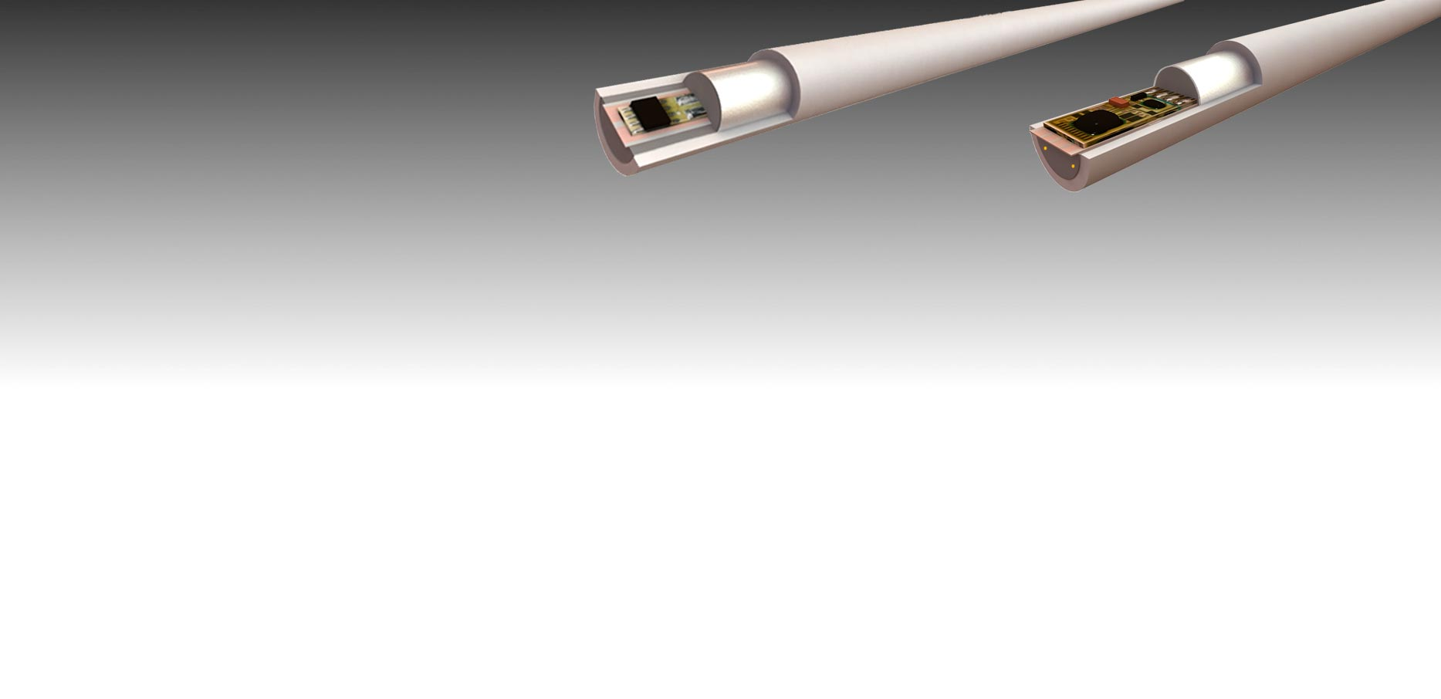
SPECIFICATIONS Sensor Cables
Reinforced, Aluminium shielded, flame retardant and halogen free cables.
Criteria | SEC 15 (d-LIST) | SEC 20
Max. Cable Length | 700 m (2x350 m) | 3’200 m
Typical use | Industry, belt conveyors, elevators | Road & Rail Tunnels, long belt conveyors
Sensor Spacing | 1 / 2 / 3 / 4 / 5 / 10 m | 2 / 4 / 5 / 6 / 8 / 10 m
Measurement Temp. Range | -40°C to +120°C | -40°C to +200°C
Resolution (Measurement Reading) | 0.1°C | 0.1°C
Operating Temp. Range | Continuous: -40°C to +85°C / Short term: up to max. meas. temperature
Cable Diameter | 15 mm | 18 mm
Min. Bending Radius | 25 cm | 30 cm
Max. Number of Sensors | 200 (2x100) | 350 (320 VdS), 500 temp. monitoring
Sensor Type | Embedded temperature sensor, semiconductor
Certification | EN54-22 Cl. A1N, A2N, BN, CN, ATEX Zone 2/22 | EN54-22 Cl. A1N, A2N, BN, ATEX Zone 2/22

Slide 33
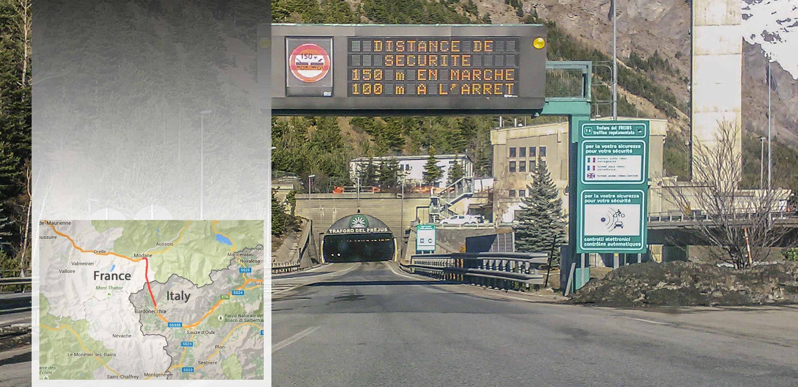
SUCCESS STORIES Fréjus, France - Italy
  Road Tunnel
  13km
  Sensor Cable Length: 12’800m

Slide 34
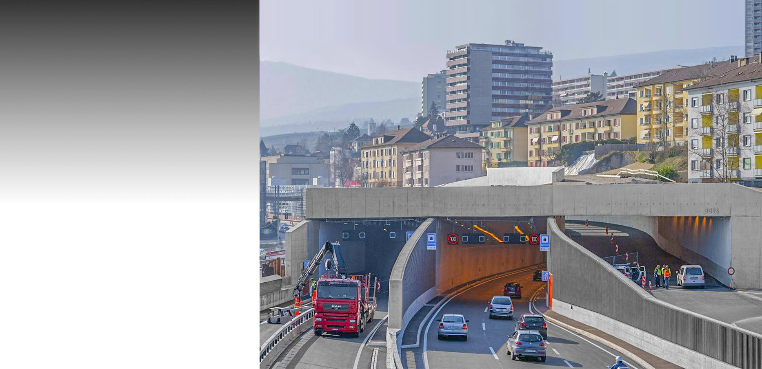
SUCCESS STORIES Bypass, Neuchâtel, Switzerland
  Road Tunnel
  7’100m
  Sensor Cable Length: 14’200m

Slide 35
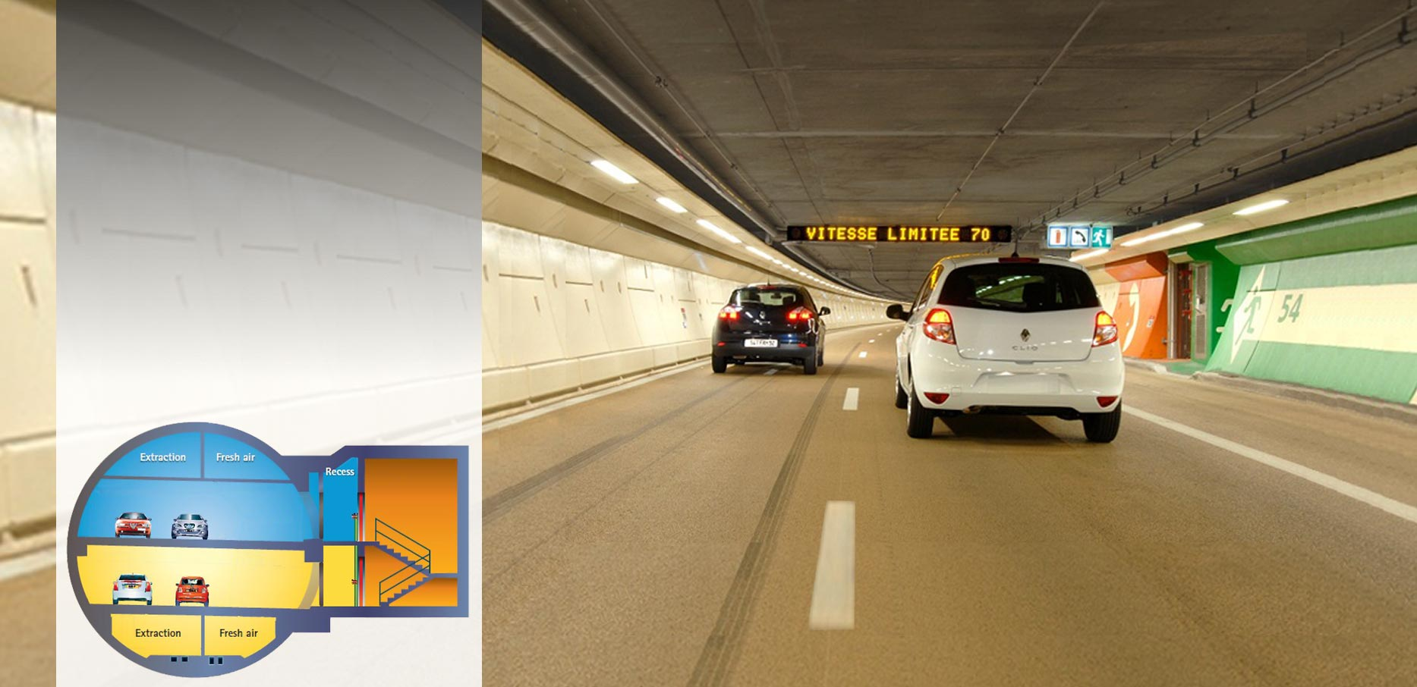
SUCCESS STORIES A86, Paris, France
  Double Deck
  Road Tunnel
  10km in 2 sections
  Sensor Cable Length: 10’400m

Slide 36
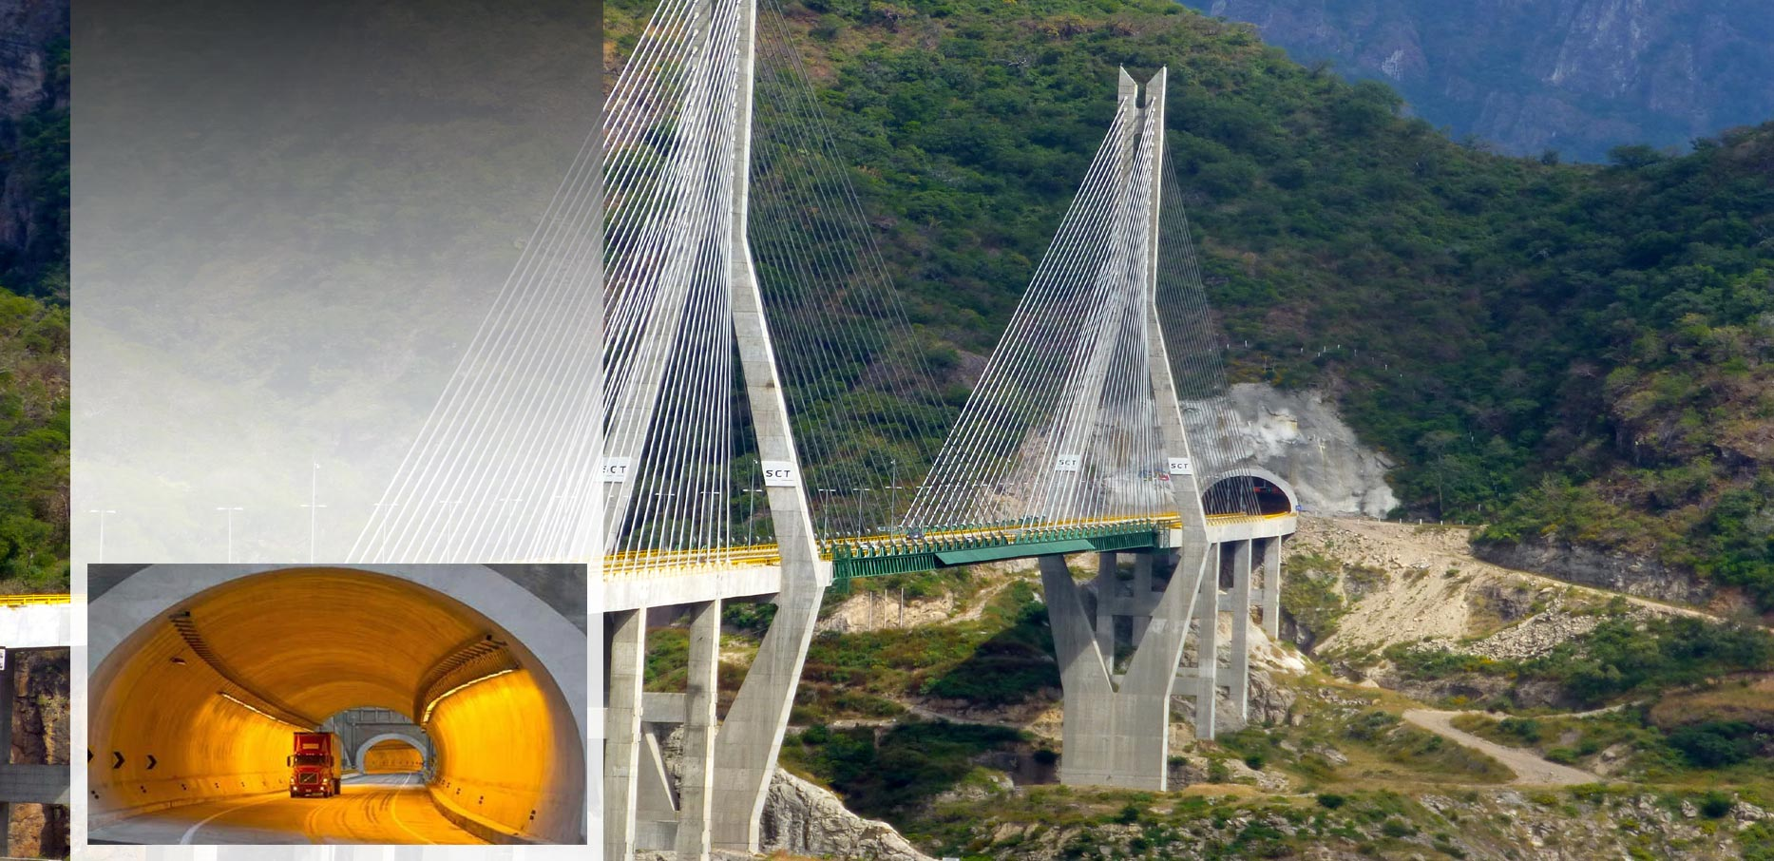
SUCCESS STORIES El Sinaloense, Durango, Mexico
  Road Tunnel
  2’787m
  Sensor Cable Length: 2’794m

Slide 37
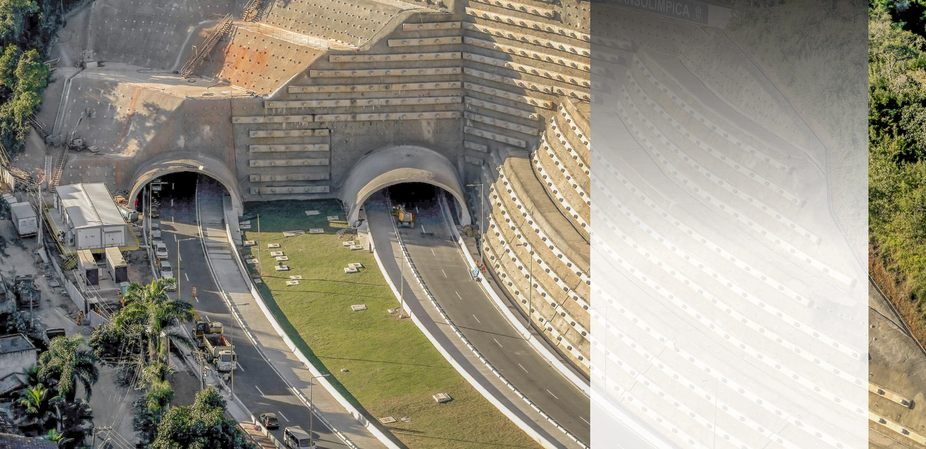
SUCCESS STORIES Senador Nelson Carneiro, Rio de Janeiro, Brazil
  Road Tunnel
  1’800m
  Sensor Cable Length: 3’800m

Slide 38
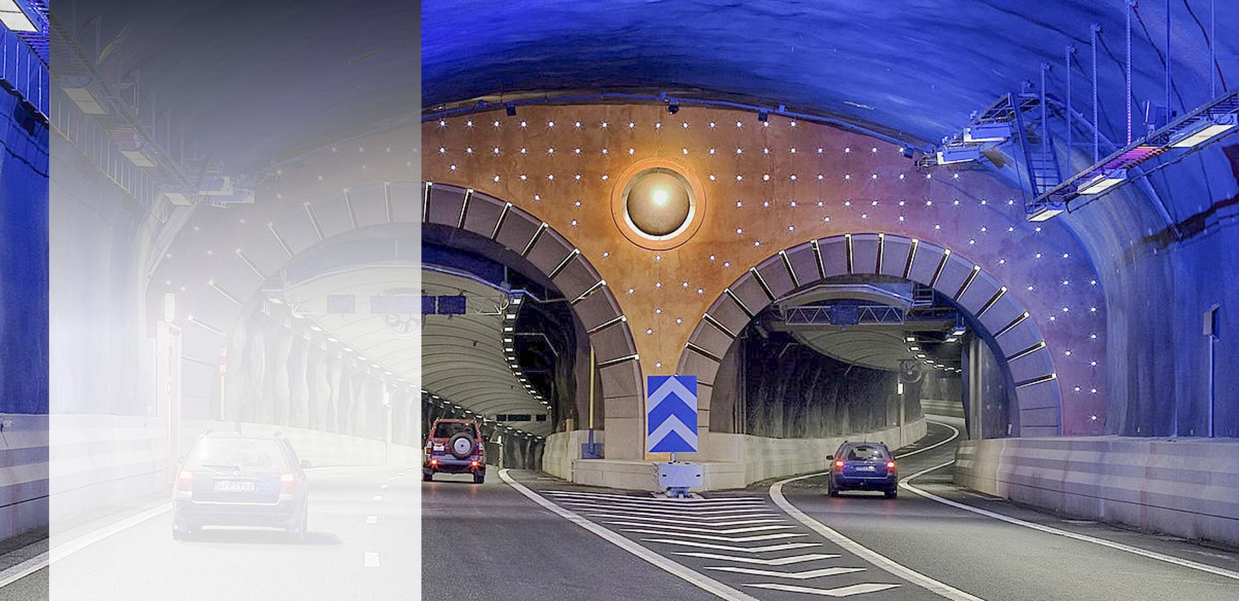
SUCCESS STORIES Södra Länken, Stockholm, Sweden
  Road Tunnel
  4’700m
  Sensor Cable Length: 10’400m

Slide 39
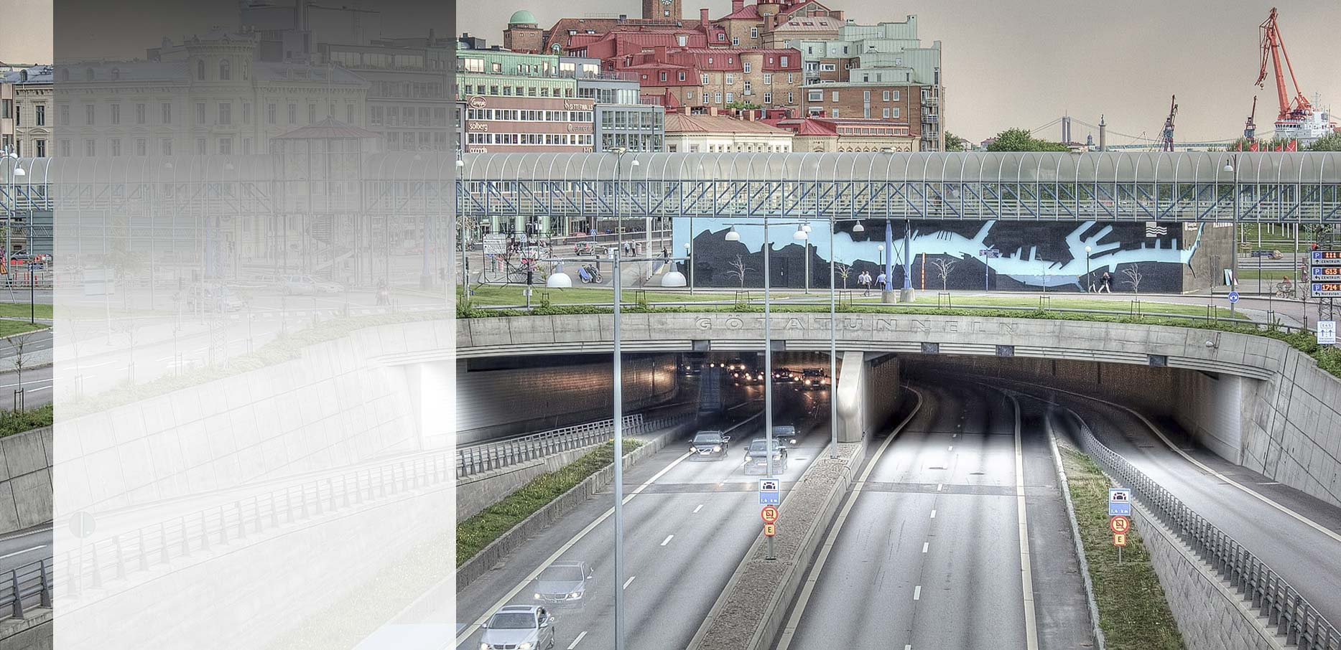
SUCCESS STORIES Göta, Gothenburg, Sweden
  Road Tunnel
  1’600m
  Sensor Cable Length: 3’400m

Slide 40
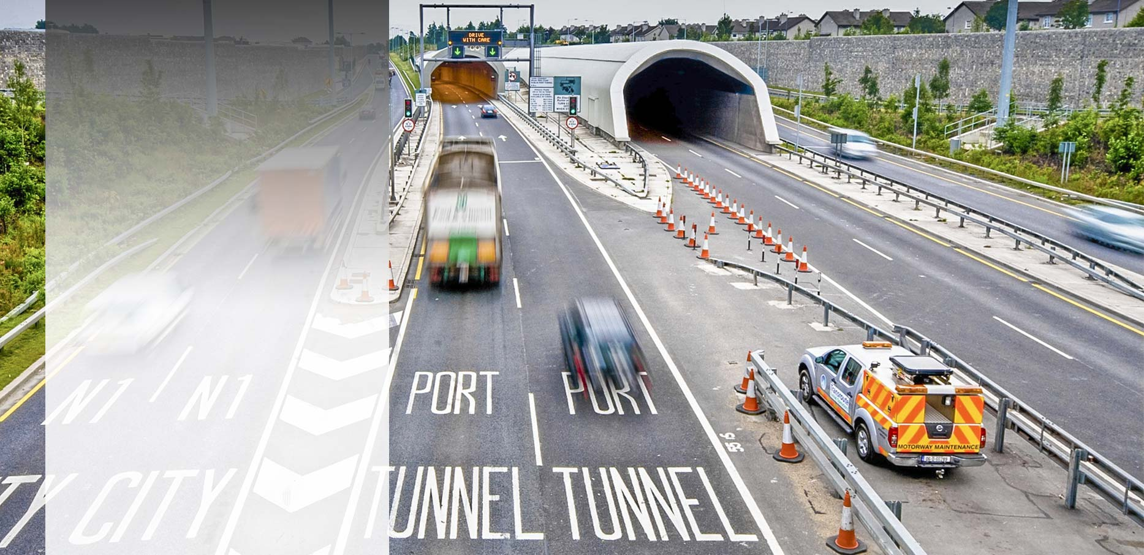
SUCCESS STORIES Port tunnel, Dublin, Ireland
  Road Tunnel
  4’500m
  Sensor Cable Length: 8’900m

Slide 41
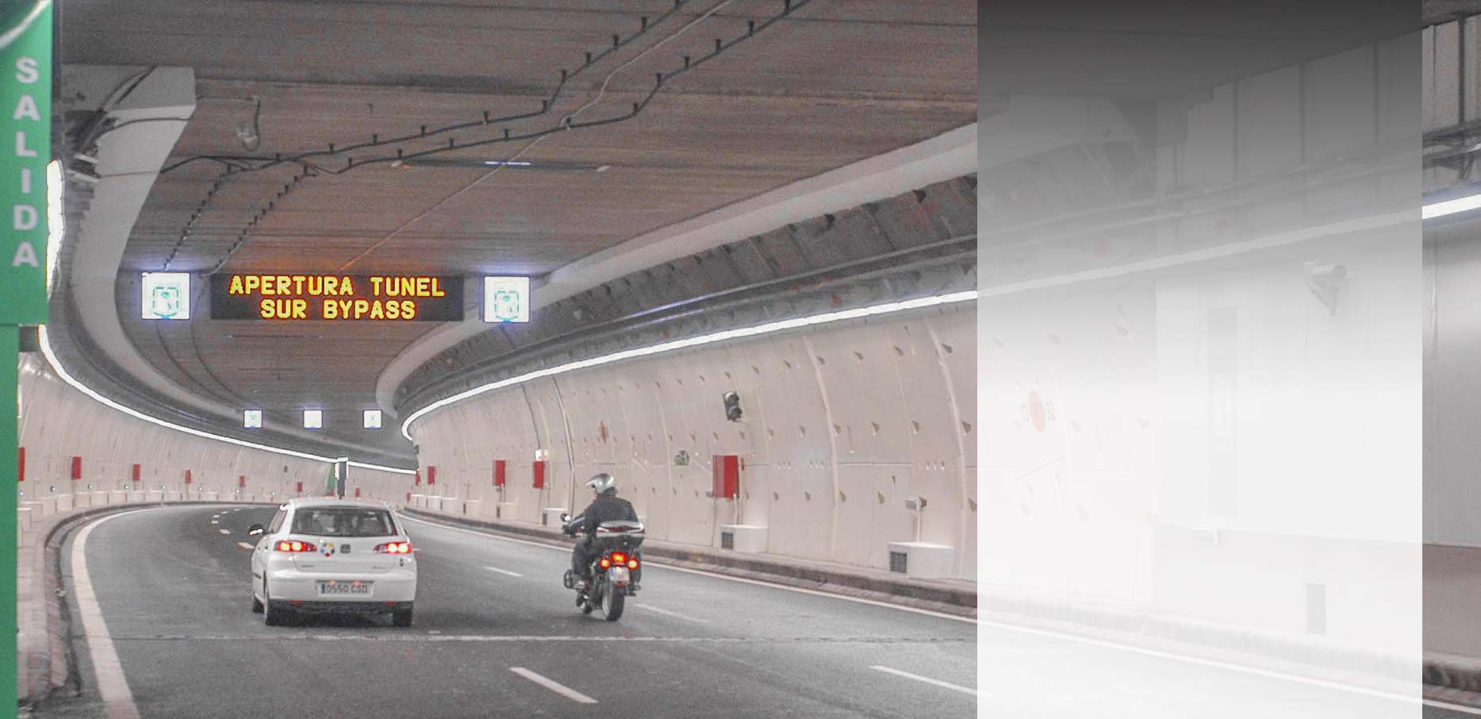
SUCCESS STORIES M30 Airport, Madrid, Spain
  Road Tunnel
  1’306m
  Sensor Cable Length: 2’600m

Slide 42
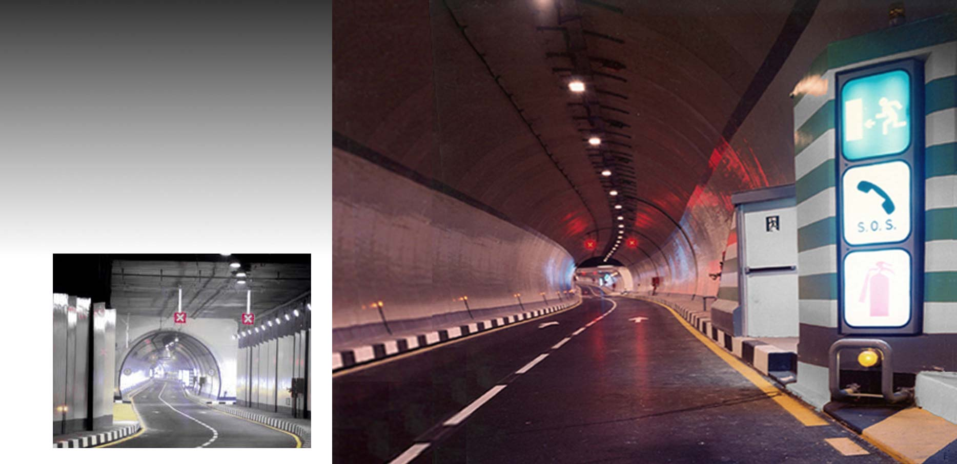
SUCCESS STORIES Al-Azhar, Cairo, Egypt
  Road Tunnel
  2’700m
  Sensor Cable Length: 2’330m

Slide 43
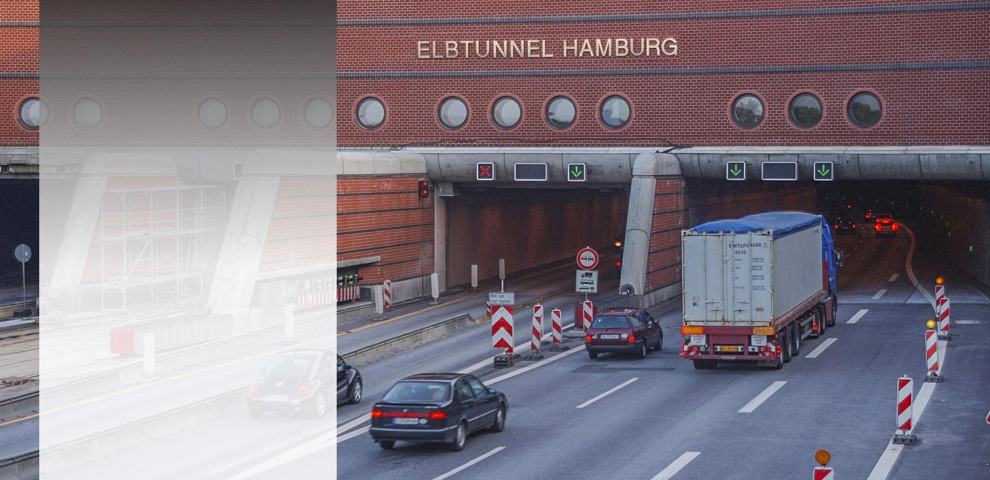
SUCCESS STORIES Elbtunnel, Hamburg, Germany
  Road Tunnel
  12’400m
  Sensor Cable Length: 11’600m

Slide 44
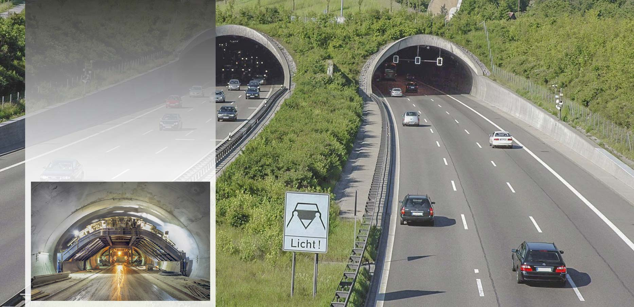
SUCCESS STORIES Engelberg, Stuttgart, Germany
  Road Tunnel
  2’530m
  Sensor Cable Length: 5’000m

Slide 45
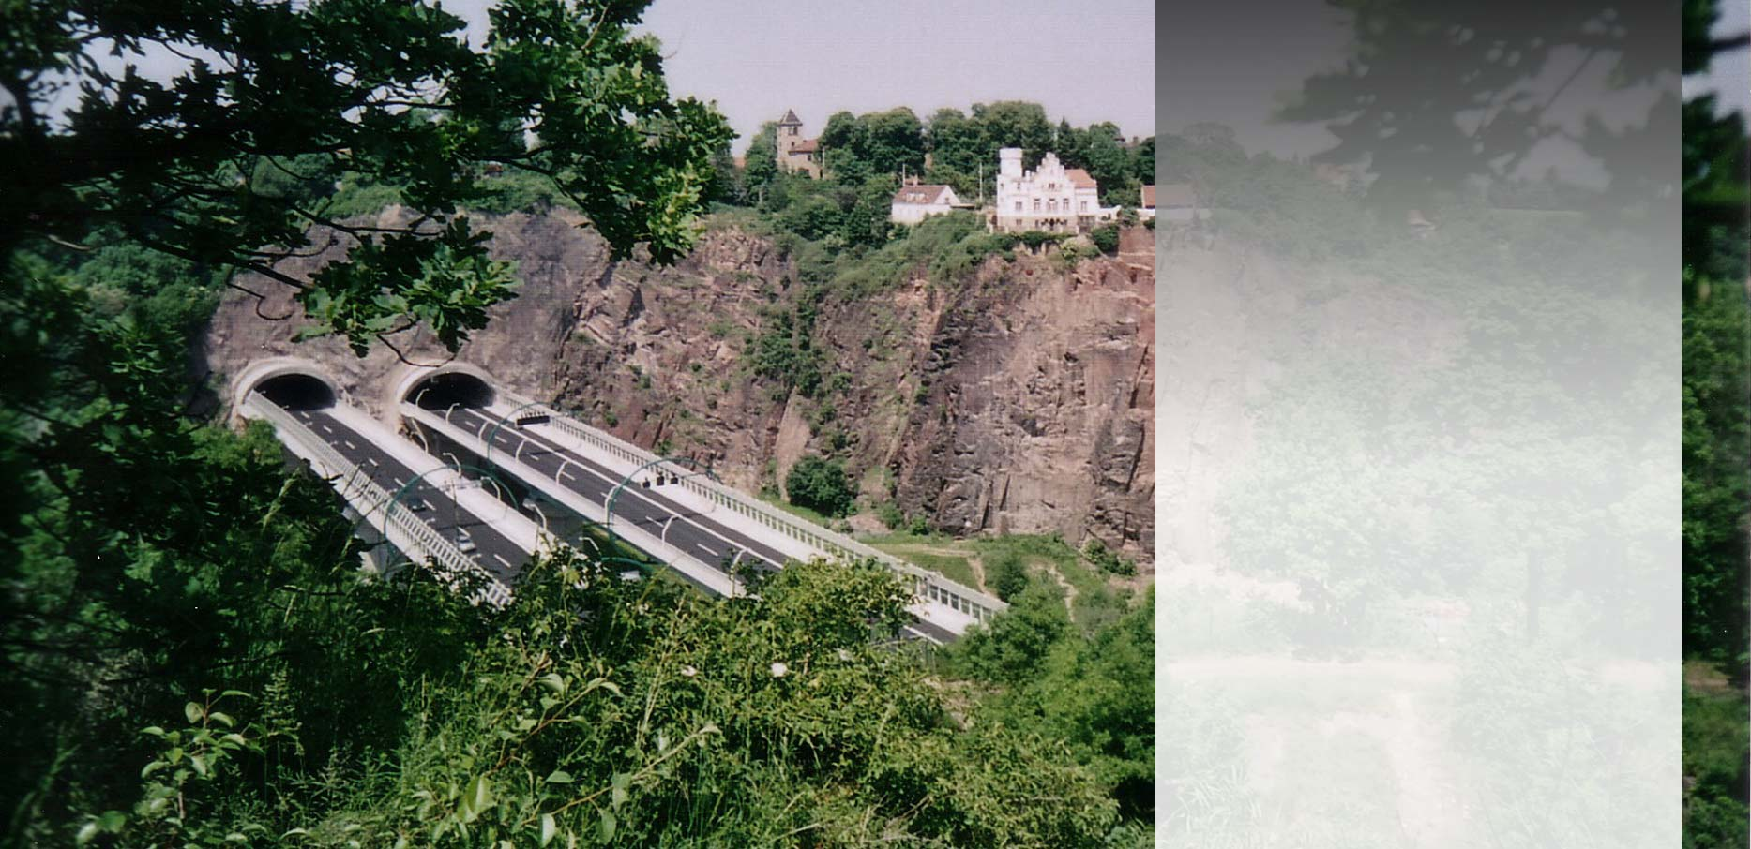
SUCCESS STORIES Coschützer, Dresden, Germany
  Road Tunnel
  2’332m
  Sensor Cable Length: 4’600m

Slide 46
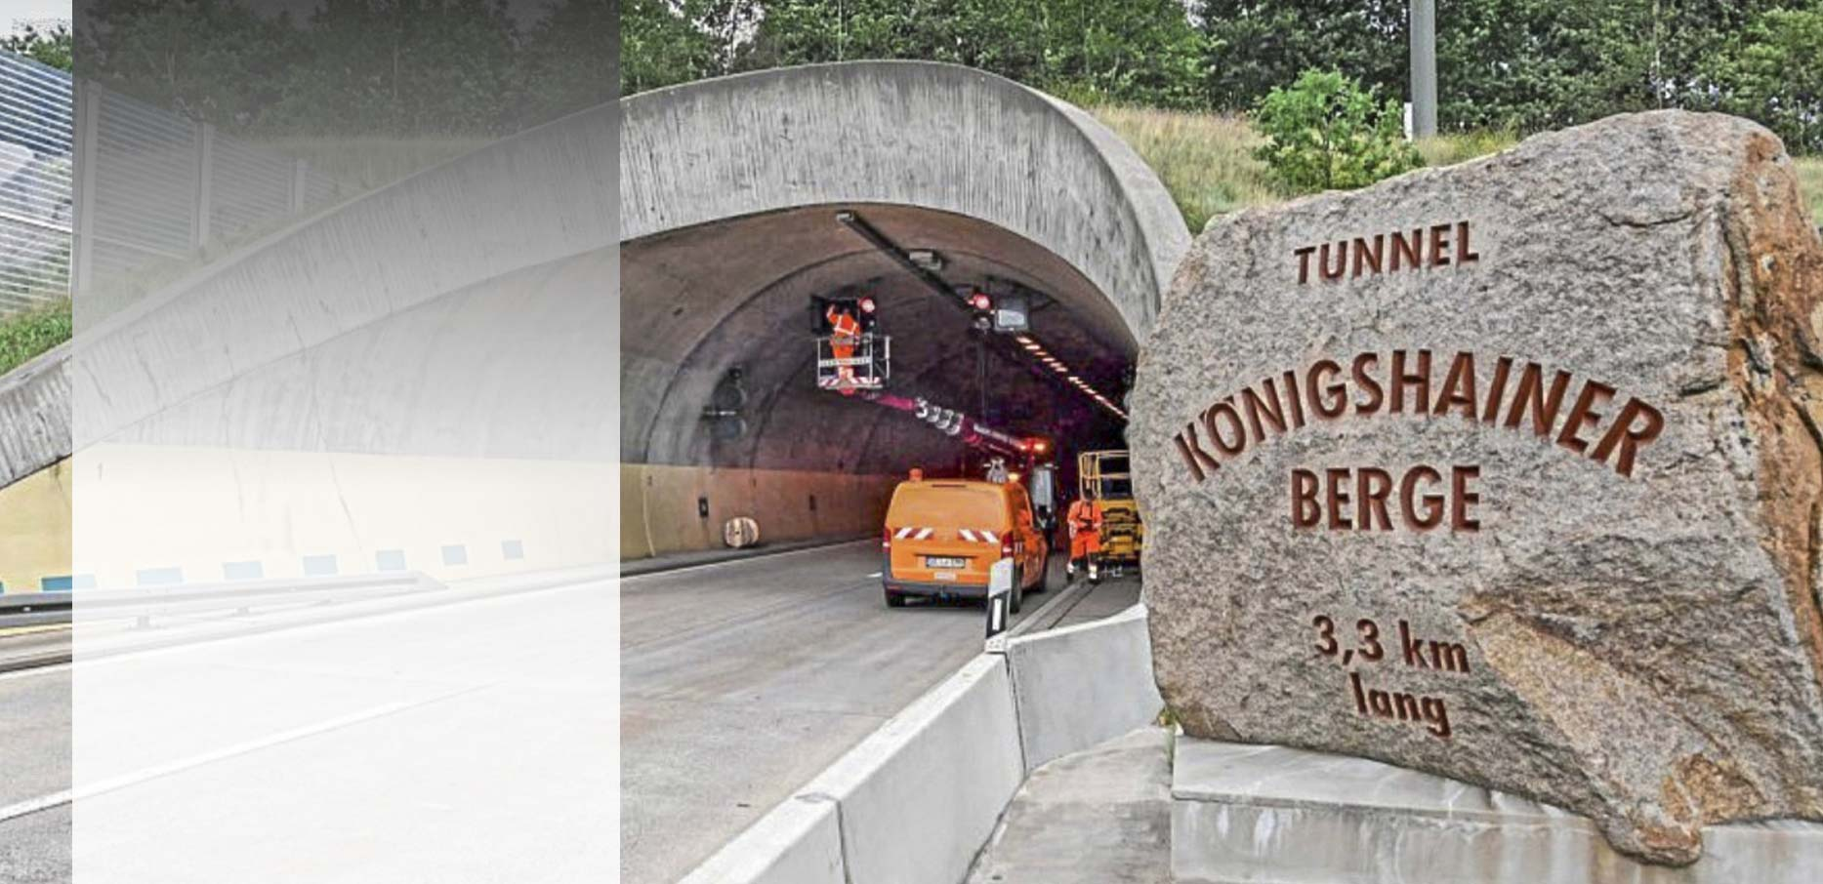
SUCCESS STORIES Königshainer Berge, Görlitz, Germany
  Road Tunnel
  3’281m
  Sensor Cable Length: 6’562m

Slide 47
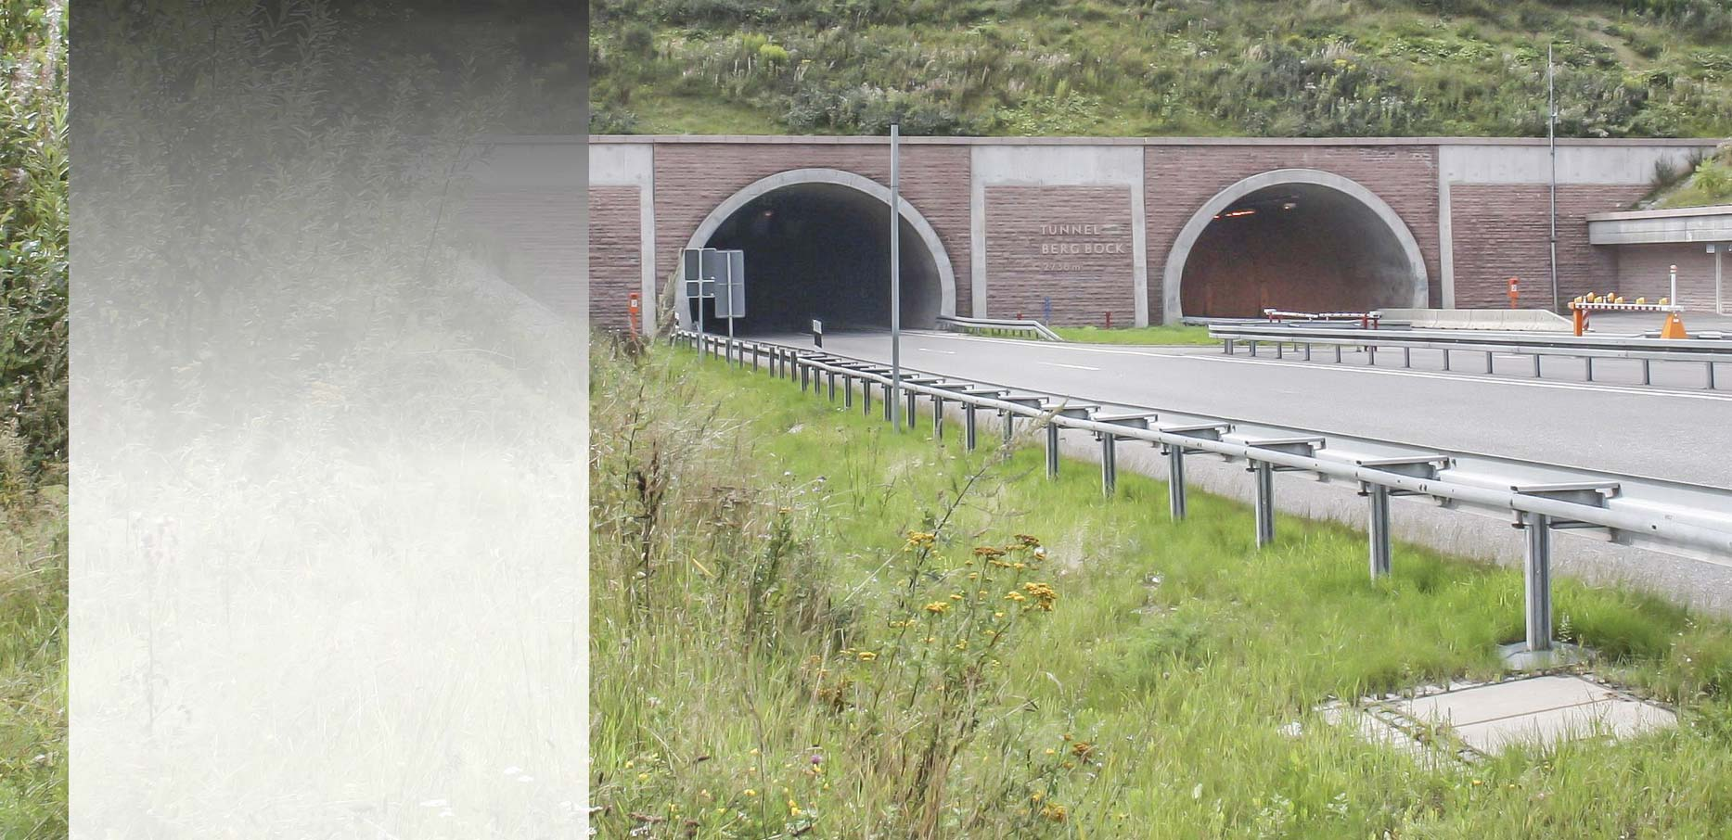
SUCCESS STORIES Berg Bock, Suhl, Germany
  Road Tunnel
  2’738m
  Sensor Cable Length: 5’500m

Slide 48
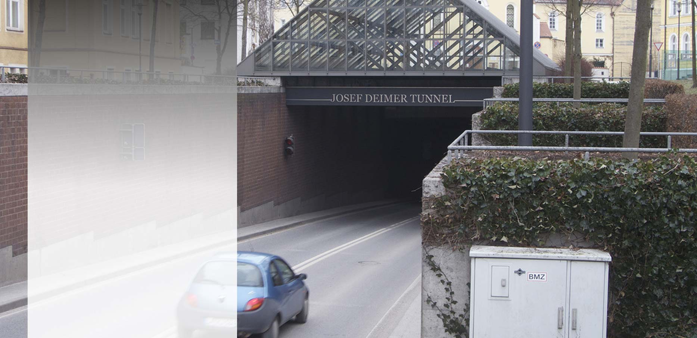
SUCCESS STORIES Josef Deimer, Landshut, Germany
  Road Tunnel
  1’470m
  Sensor Cable Length: 1’470m

Slide 49
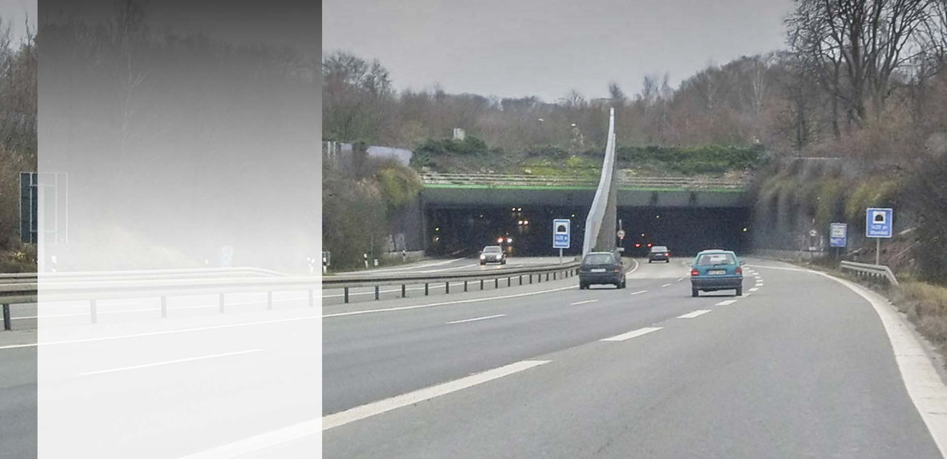
SUCCESS STORIES Wambel, Dortmund, Germany
  Road Tunnel
  1’420m
  Sensor Cable Length: 3’260m

Slide 50
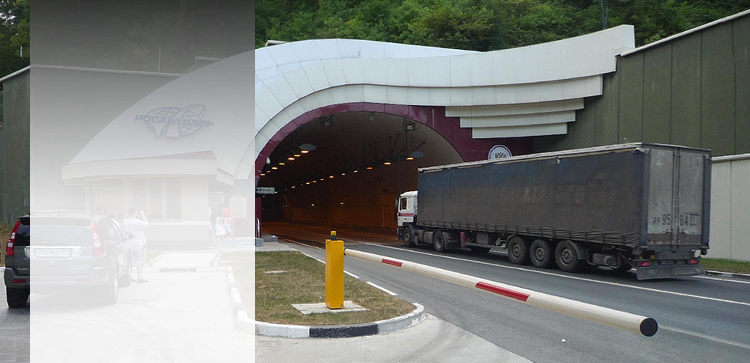
SUCCESS STORIES Bypass Tunnel, Sochi, Russia
  Road Tunnel
  2’600m
  Sensor Cable Length: 5’350m

Slide 51
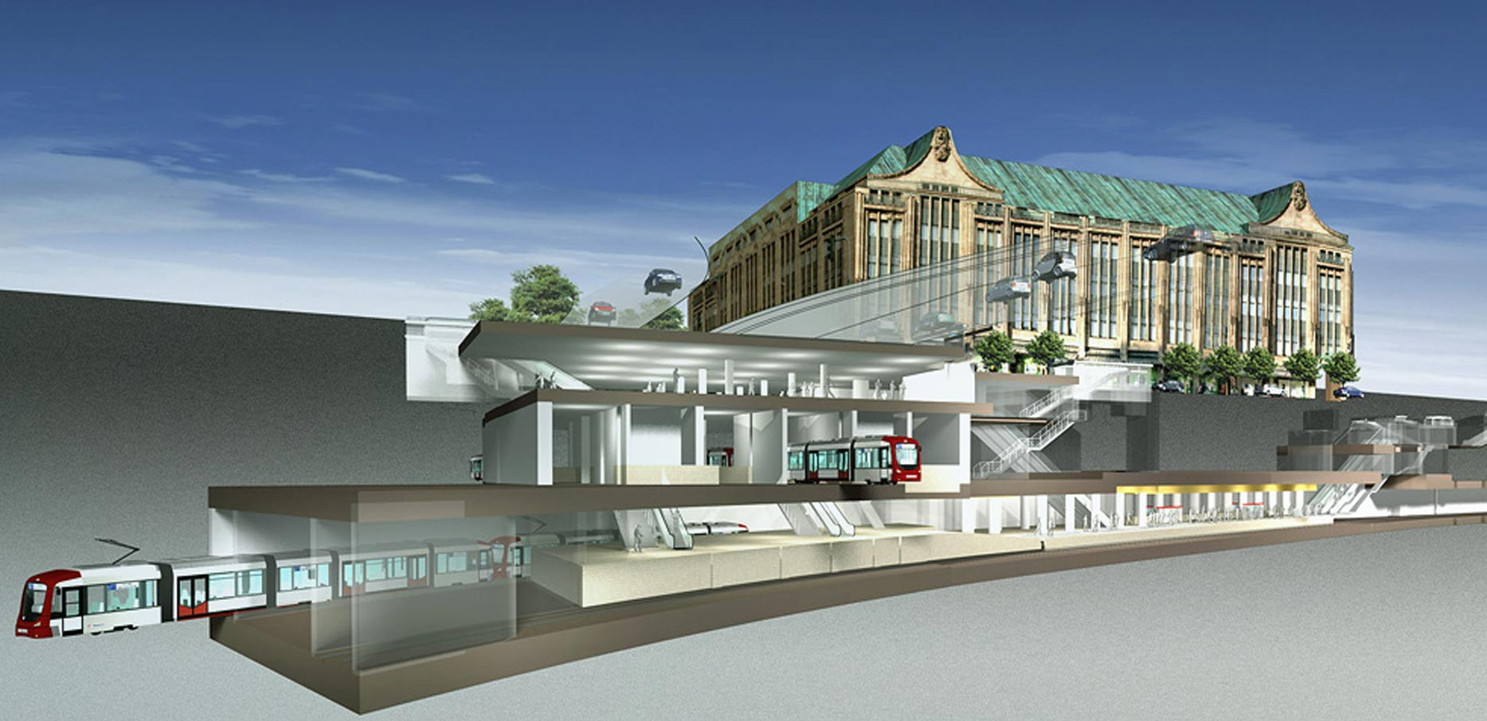
SUCCESS STORIES Metro Station, Düsseldorf, Germany
  Fire Detection at the Station “Heinrich-Heine-Allee”

Slide 52
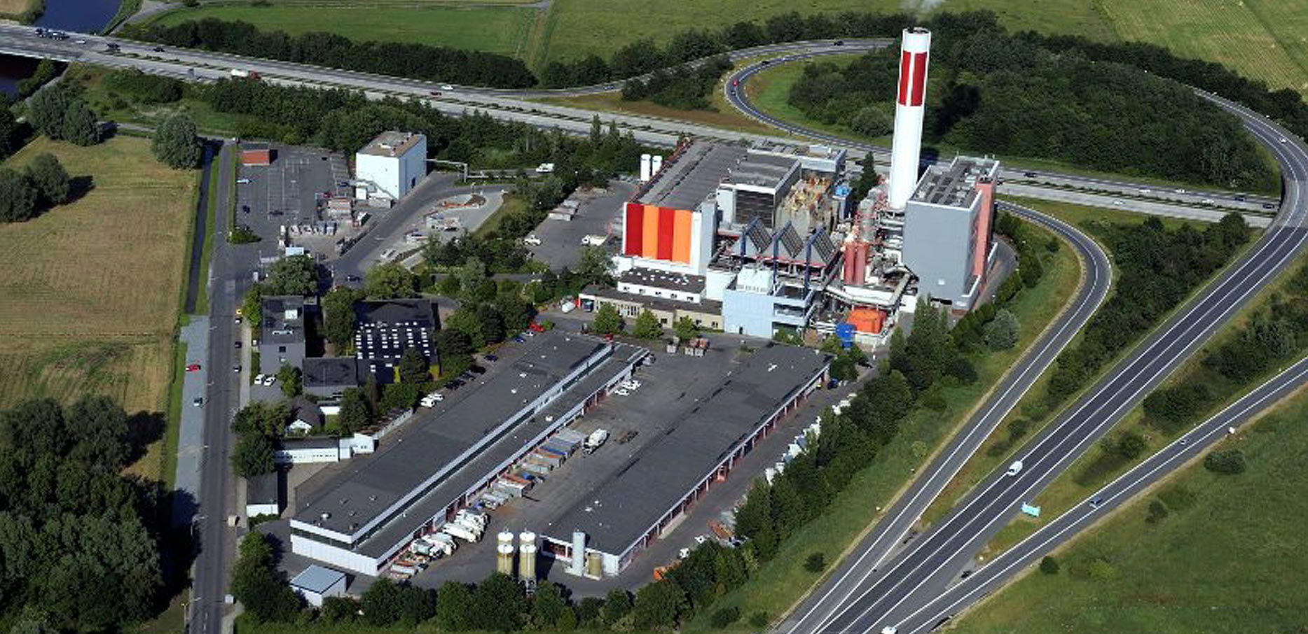
SUCCESS STORIES Garbage Incinerator, Bremerhaven, Germany
  Heat Monitoring of Conveying Systems

Slide 53
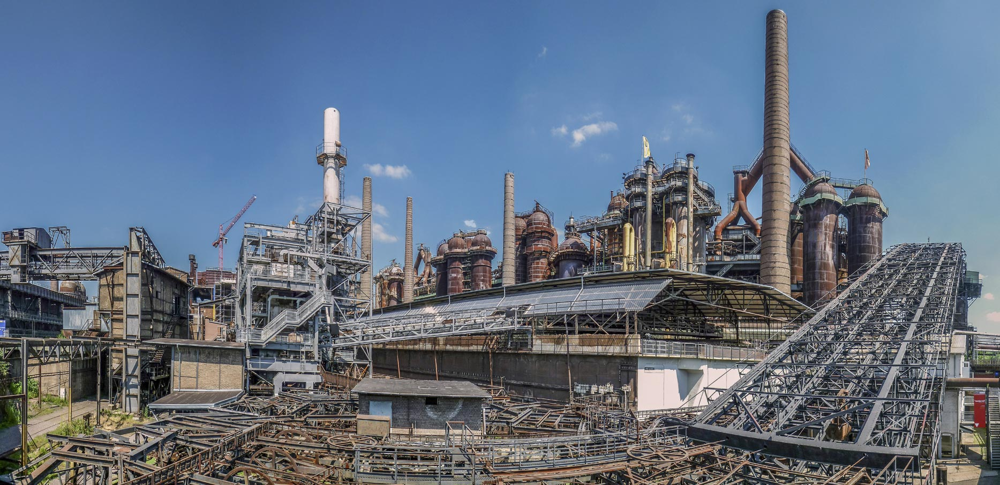
SUCCESS STORIES Saarbergwerke, Völklingen, Germany
  Heat Monitoring of Conveying Systems

Slide 54

SUCCESS STORIES Coal Power Station, Patnow, Poland
  Heat Monitoring of Conveying Systems

Slide 55

Industrial grade
HEAT MONITORING
and
FIRE DETECTION
Thank You!
Securiton AG
Alpenstrasse 20
CH – 3052 Zollikofen
www.securiton.com
+41 58 910 50 50

